Slide 1
NetSim IoT
ML based classifier to detect attacks in RPL based IoT networks
Applicable Release: NetSim v14.3 or higher
Applicable Version(s): NetSim Standard
Project download link:
The URL has the exported NetSim scenario for the examples used in this document and the python scripts to run classifiers.

Slide 2
Outline
Introduction to RPL protocol
Objective function and Link quality
Rank Calculations in NetSim
Rank attack in RPL using NetSim
Attack scenarios with malicious nodes - Training data
Attack scenarios with 2, 4, 5, 6, 8, 10, 12 and 14 malicious nodes
Data processing
Feature visualization
Attack scenarios with malicious nodes - Test data
Attack scenarios with 3, 7, 9, 11, 13, and 15 malicious nodes
Data processing
Feature visualization
Classification
Detection of malicious nodes using ML based classifiers
Confusion Matrix: Accuracy, Precision, F1 Score, Recall
Comparison between different classifiers: Logistic Regression, Naïve Bayes, KNN, Support Vector Machine

Slide 3
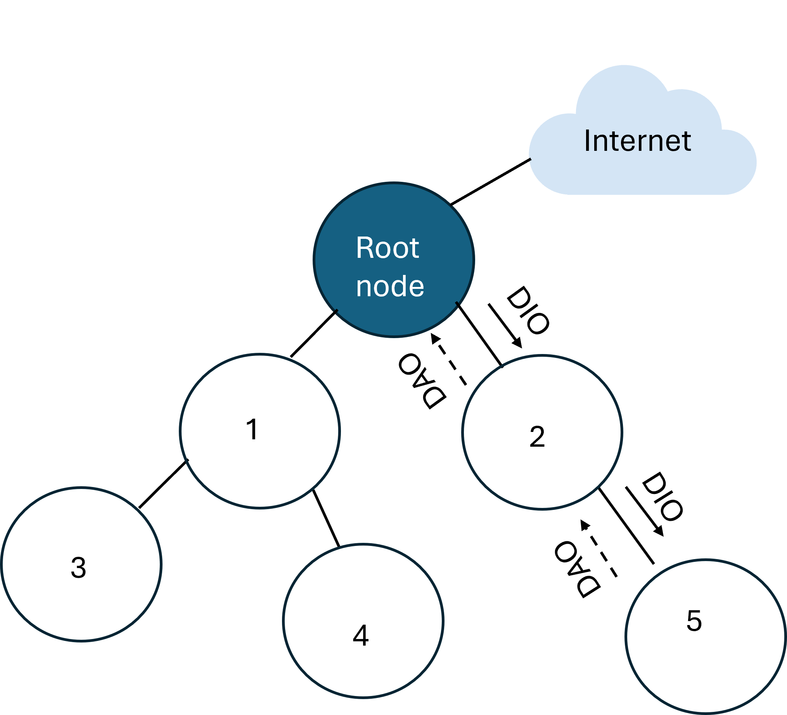
Introduction to RPL Protocol
RPL: Routing Protocol for Low-Power and Lossy Networks.
Purpose: Designed for IPv6-based routing in Low-Power and Lossy Networks (LLNs)
Key concept: Constructs a Directed Acyclic Graph (DAG) rooted at the sink
Goal: Minimize the cost of reaching the sink from any node based on the Objective Function (OF)
Key Terminology:
DAG (Directed Acyclic Graph): A directed graph without cycles
DAG root: Node with o outgoing edges
DODAG ID: Unique IPv6 ID assigned to the root
Rank: Defines node positions relative to the DODAG root
RPL implementation in NetSim is based on RFC 6550.
Control messages in RPL
RFC Reference: https://www.rfc-editor.org/rfc/rfc6550

Slide 4
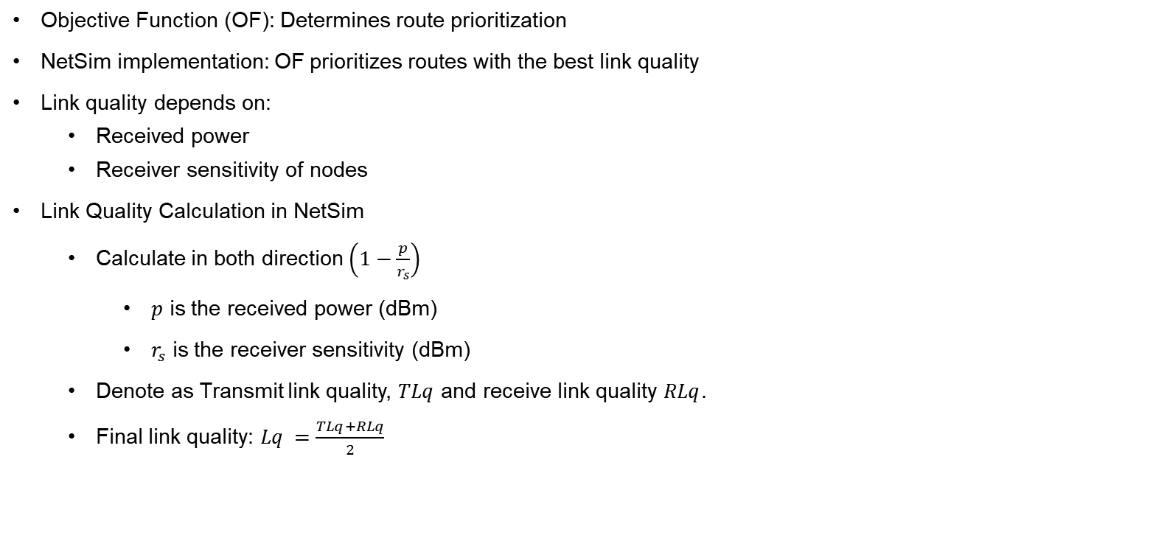
Objective function and Link quality
Objective Function (OF): Determines route prioritization
NetSim implementation: OF prioritizes routes with the best link quality
Link quality depends on:
Received power
Receiver sensitivity of nodes
Link Quality Calculation in NetSim
Calculate in both direction$\left(1−\frac{p}{r_{s}}\right)$
$p$ is the received power (dBm)
$r_{s}$ is the receiver sensitivity (dBm)
Denote as Transmit link quality, $TLq$ and receive link quality $RLq$.
Final link quality: $Lq =\frac{TLq+RLq}{2}$

Slide 5
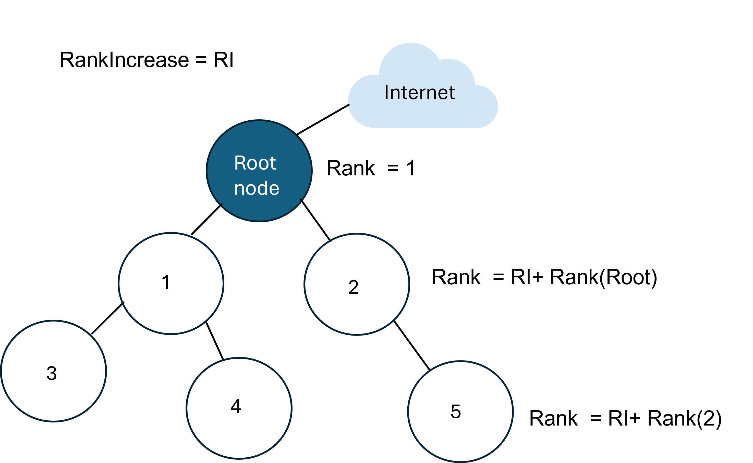
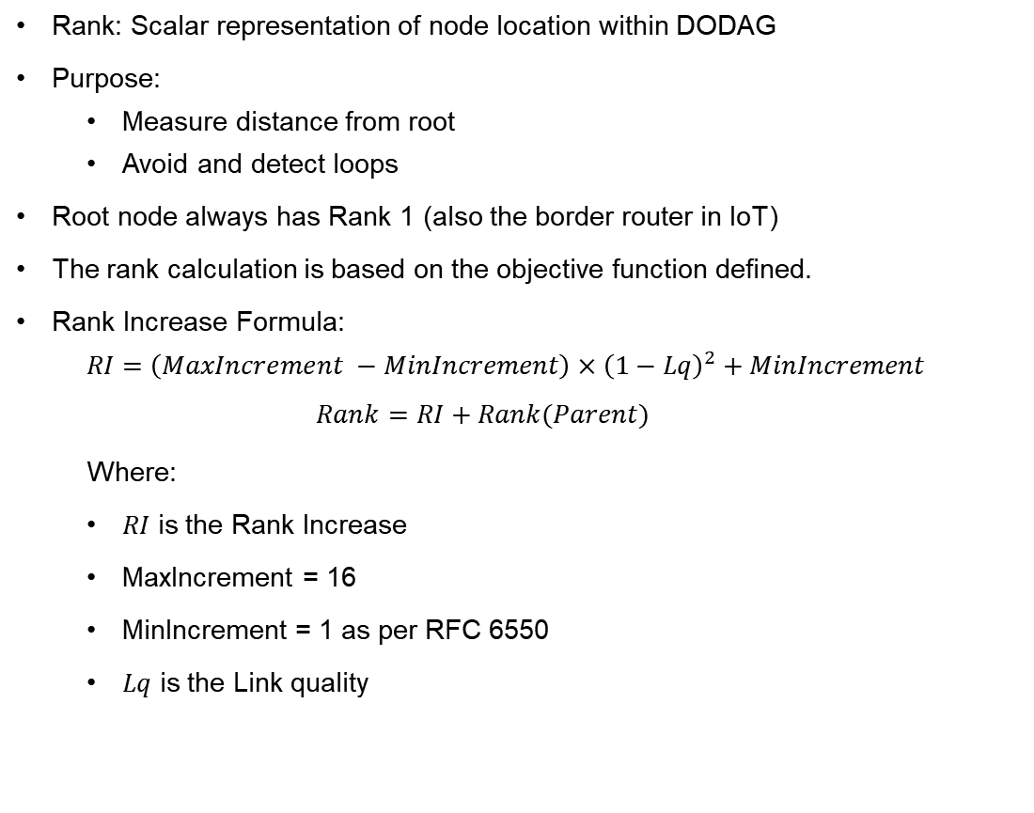
Rank calculation in NetSim
Rank: Scalar representation of node location within DODAG
Purpose:
Measure distance from root
Avoid and detect loops
Root node always has Rank 1 (also the border router in IoT)
The rank calculation is based on the objective function defined.
Rank Increase Formula:
$$RI=\left(MaxIncrement −MinIncrement\right)×{\left(1−Lq\right)}^{2}+MinIncrement$$
$$Rank=RI+Rank(Parent)$$
Where:
$RI$ is the Rank Increase
MaxIncrement = 16
MinIncrement = 1 as per RFC 6550
$Lq$ is the Link quality
DODAG with Node Ranks in an IoT Network

Slide 6
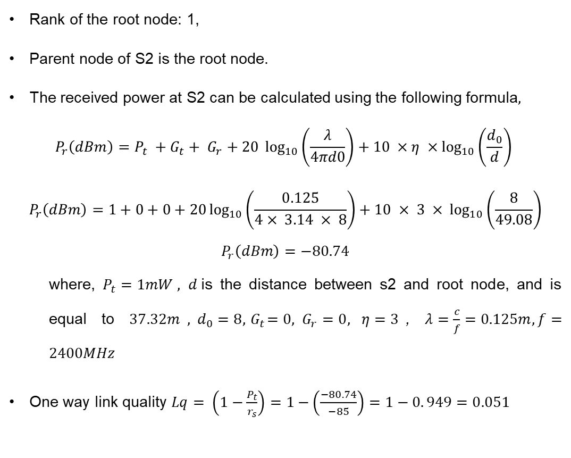
Example calculation for better understanding
Rank of the root node: 1,
Parent node of S2 is the root node.
The received power at S2 can be calculated using the following formula$,$
$$P_{r}\left(dBm\right)=P_{t} +G_{t}+ G_{r}+20 \log_{10}\left(\frac{λ}{4πd0}\right)+10 ×η ×\log_{10}\left(\frac{d_{0}}{d}\right)$$
$$P_{r}\left(dBm\right)=1+0+0+20\log_{10}\left(\frac{0.125}{4× 3.14 × 8}\right)+10 × 3 ×\log_{10}\left(\frac{8}{49.08}\right)$$
$$P_{r}\left(dBm\right)=−80.74$$
where, $P_{t}=1mW ,$ $d$is the distance between s2 and root node, and is equal to $37.32m$,$d_{0}=8,{ G}_{t}=0, G_{r}=0, η=3$, $λ=\frac{c}{f}=0.125m, f=2400MHz$
One way link quality $Lq= \left(1−\frac{P_{t}}{r_{s}}\right)=1−\left(\frac{−80.74}{−85}\right)=1−0. 949=0.051$
The network topology in IoT using RPL Protocol,
Pathloss Model: Log Distance, Pathloss Exponent = 3
Transmit power = 1mW, Receiver Sensitivity = -85 dBm

Slide 7
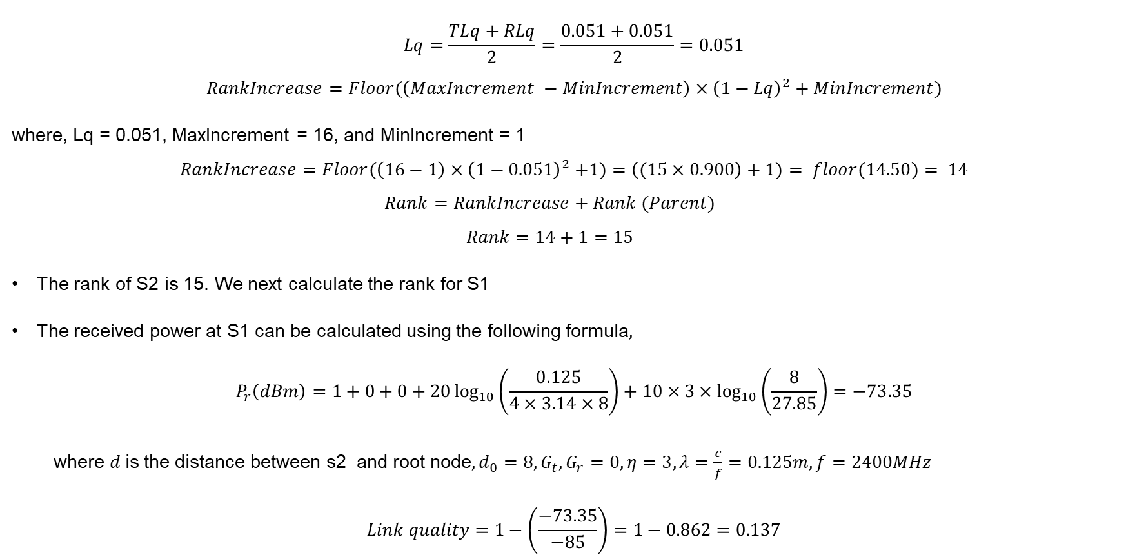
Rank calculations in NetSim
$$Lq=\frac{TLq+RLq}{2}=\frac{0.051+0.051}{2}=0.051$$
$$RankIncrease=Floor(\left(MaxIncrement −MinIncrement\right)×{\left(1−Lq\right)}^{2}+MinIncrement)$$
where, Lq = 0.051, MaxIncrement = 16, and MinIncrement = 1
$$RankIncrease=Floor(\left(16−1\right){×\left(1−0.051\right)}^{2}+1)=\left((15×0.900\right)+1)= floor(14.50)= 14$$
$$Rank=RankIncrease+Rank (Parent)$$
$$Rank=14+1=15$$
The rank of S2 is 15. We next calculate the rank for S1
The received power at S1 can be calculated using the following formula$,$
$$P_{r}\left(dBm\right)=1+0+0+20\log_{10}\left(\frac{0.125}{4×3.14×8}\right)+10×3×\log_{10}\left(\frac{8}{27.85}\right)=−73.35$$
where $d$is the distance between s2 and root node$,d_{0}=8,G_{t},G_{r}=0,η=3, λ=\frac{c}{f}=0.125m, f=2400MHz$
$$Link quality=1−\left(\frac{−73.35}{−85}\right)=1−0.862=0.137$$

Slide 8
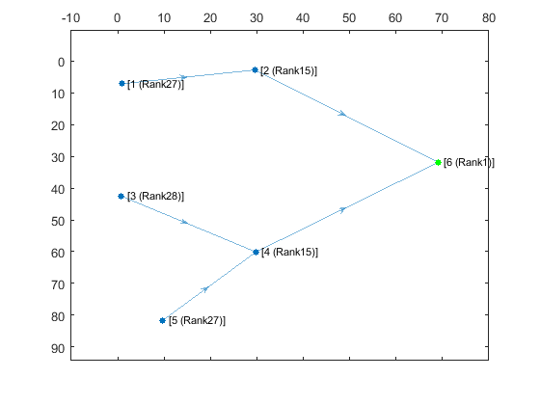
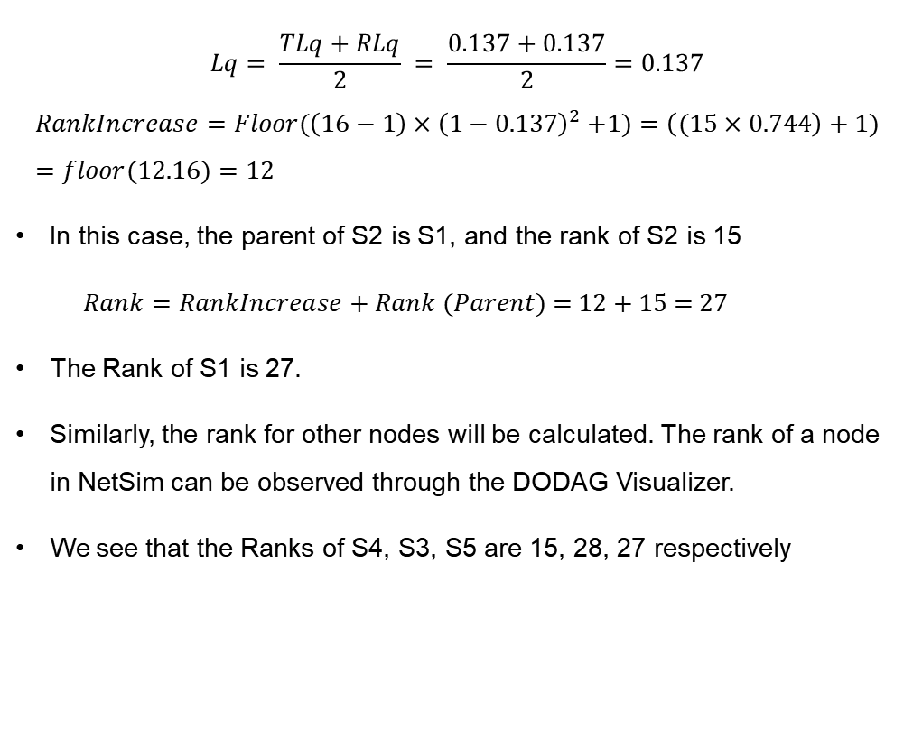
Rank calculations in NetSim
$$Lq= \frac{TLq+RLq}{2} = \frac{0.137+0.137}{2}=0.137$$
$$RankIncrease=Floor(\left(16−1\right){×\left(1−0.137\right)}^{2}+1)=\left((15×0.744\right)+1)=floor(12.16)=12$$
In this case, the parent of S2 is S1, and the rank of S2 is 15
$Rank=RankIncrease+Rank (Parent)$ = 12 + 15 = 27
The Rank of S1 is 27.
Similarly, the rank for other nodes will be calculated. The rank of a node in NetSim can be observed through the DODAG Visualizer.
We see that the Ranks of S4, S3, S5 are 15, 28, 27 respectively
DODAG visualizer showing information about rank and parent relationships

Slide 9
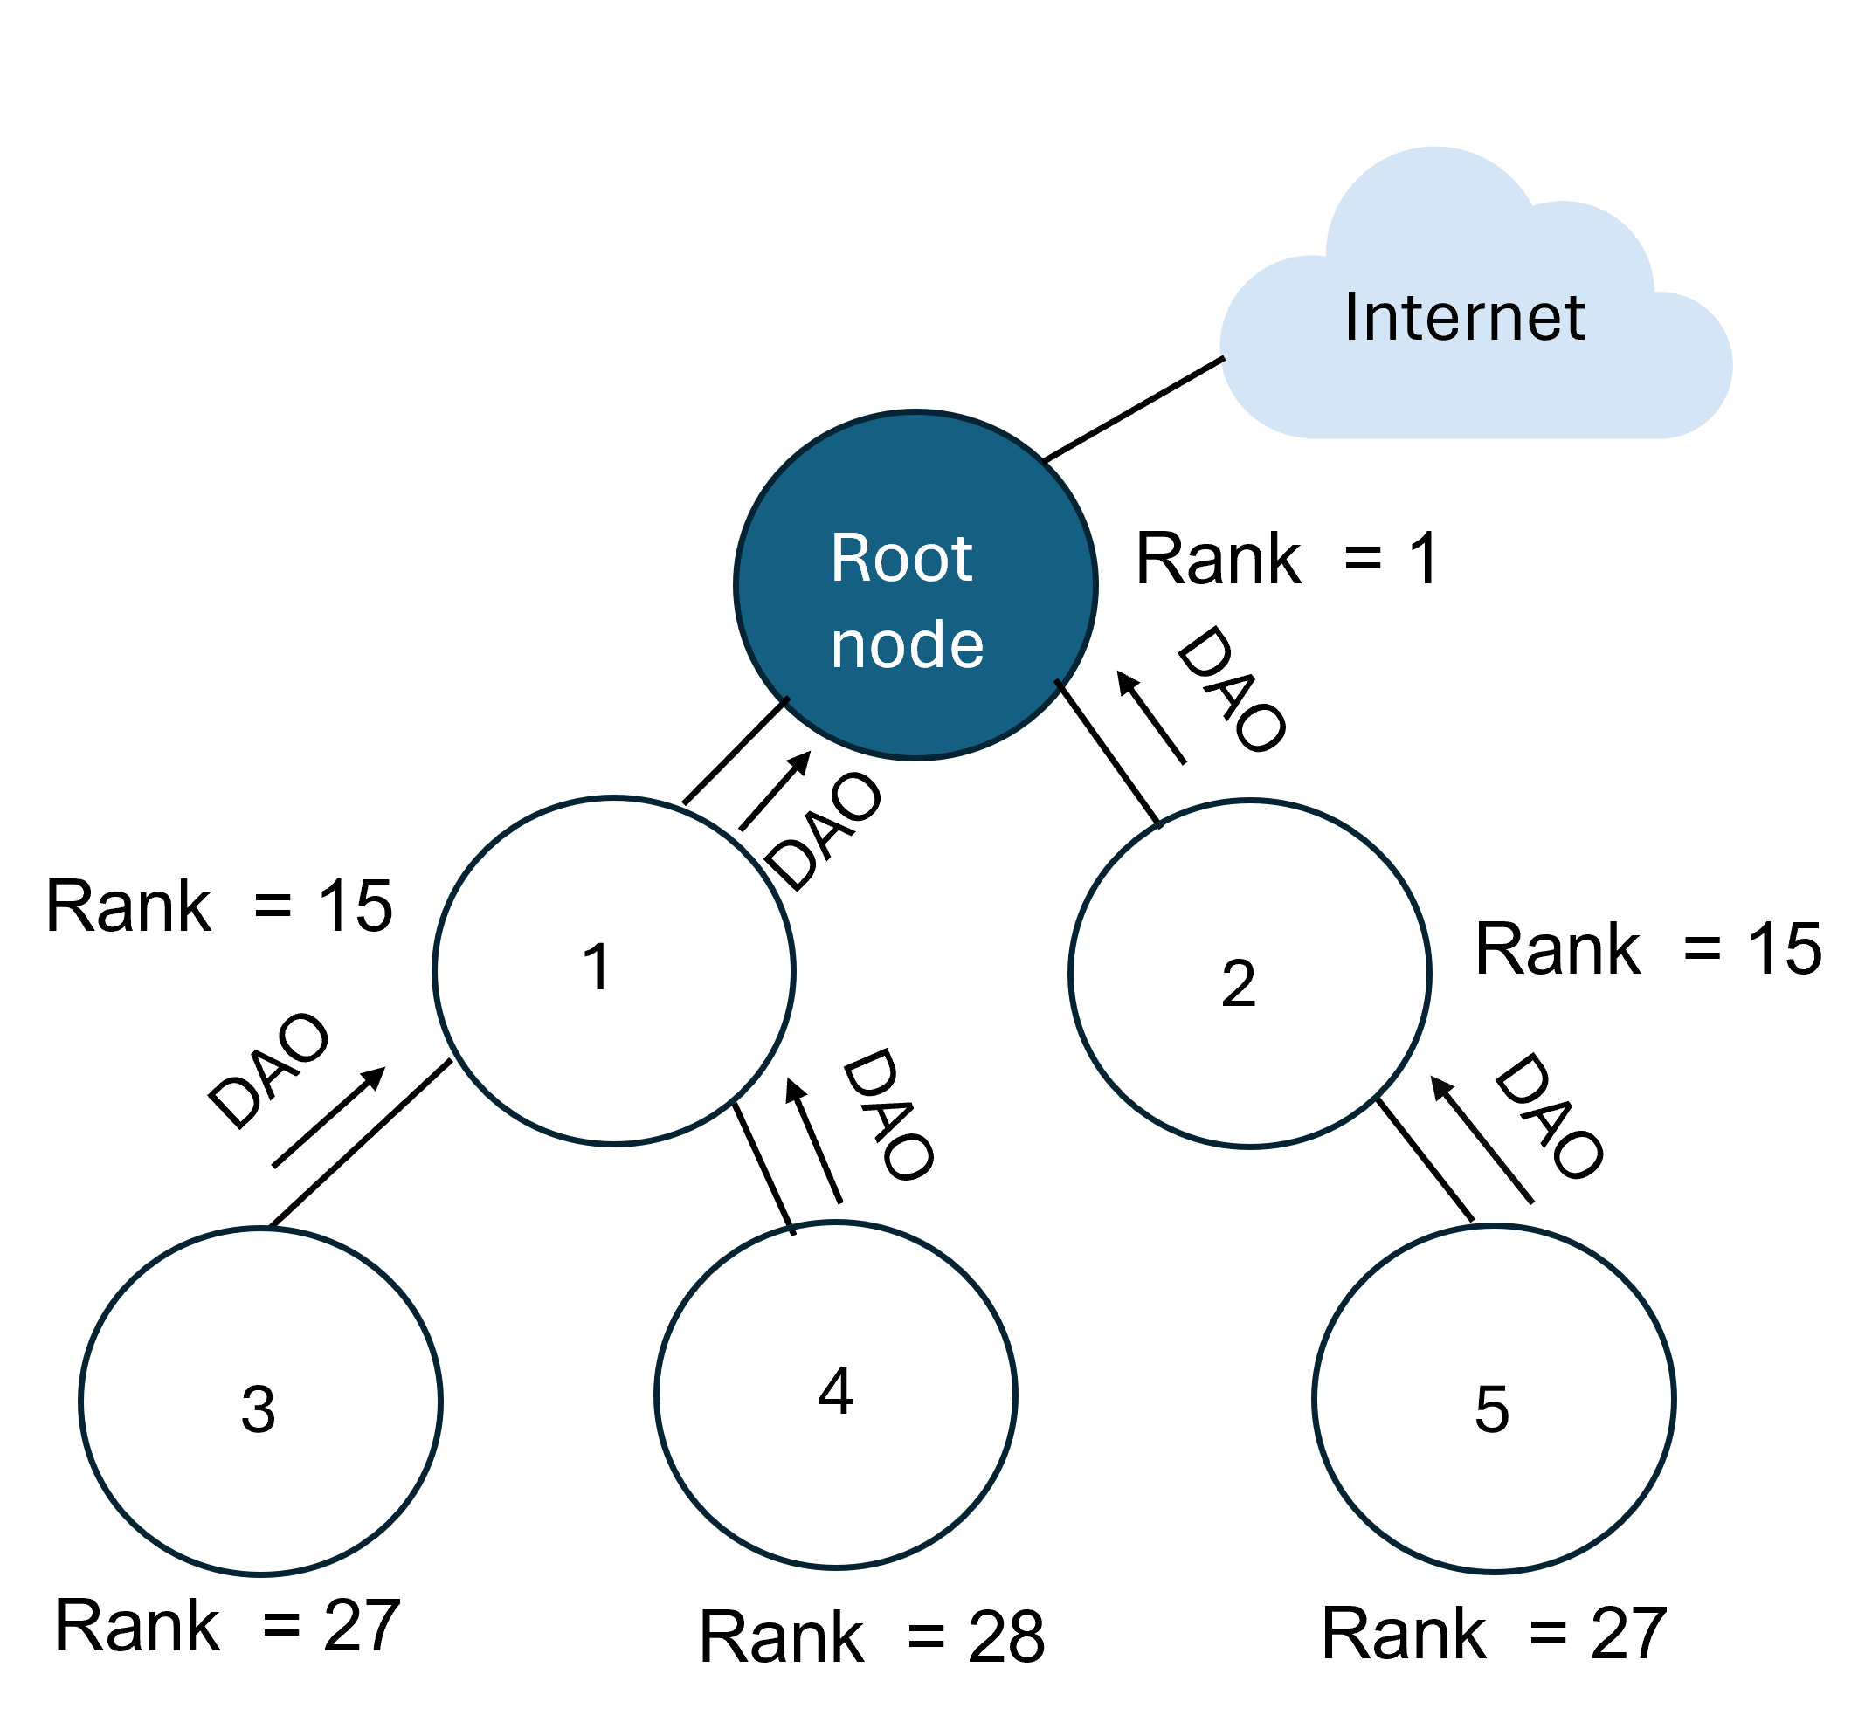
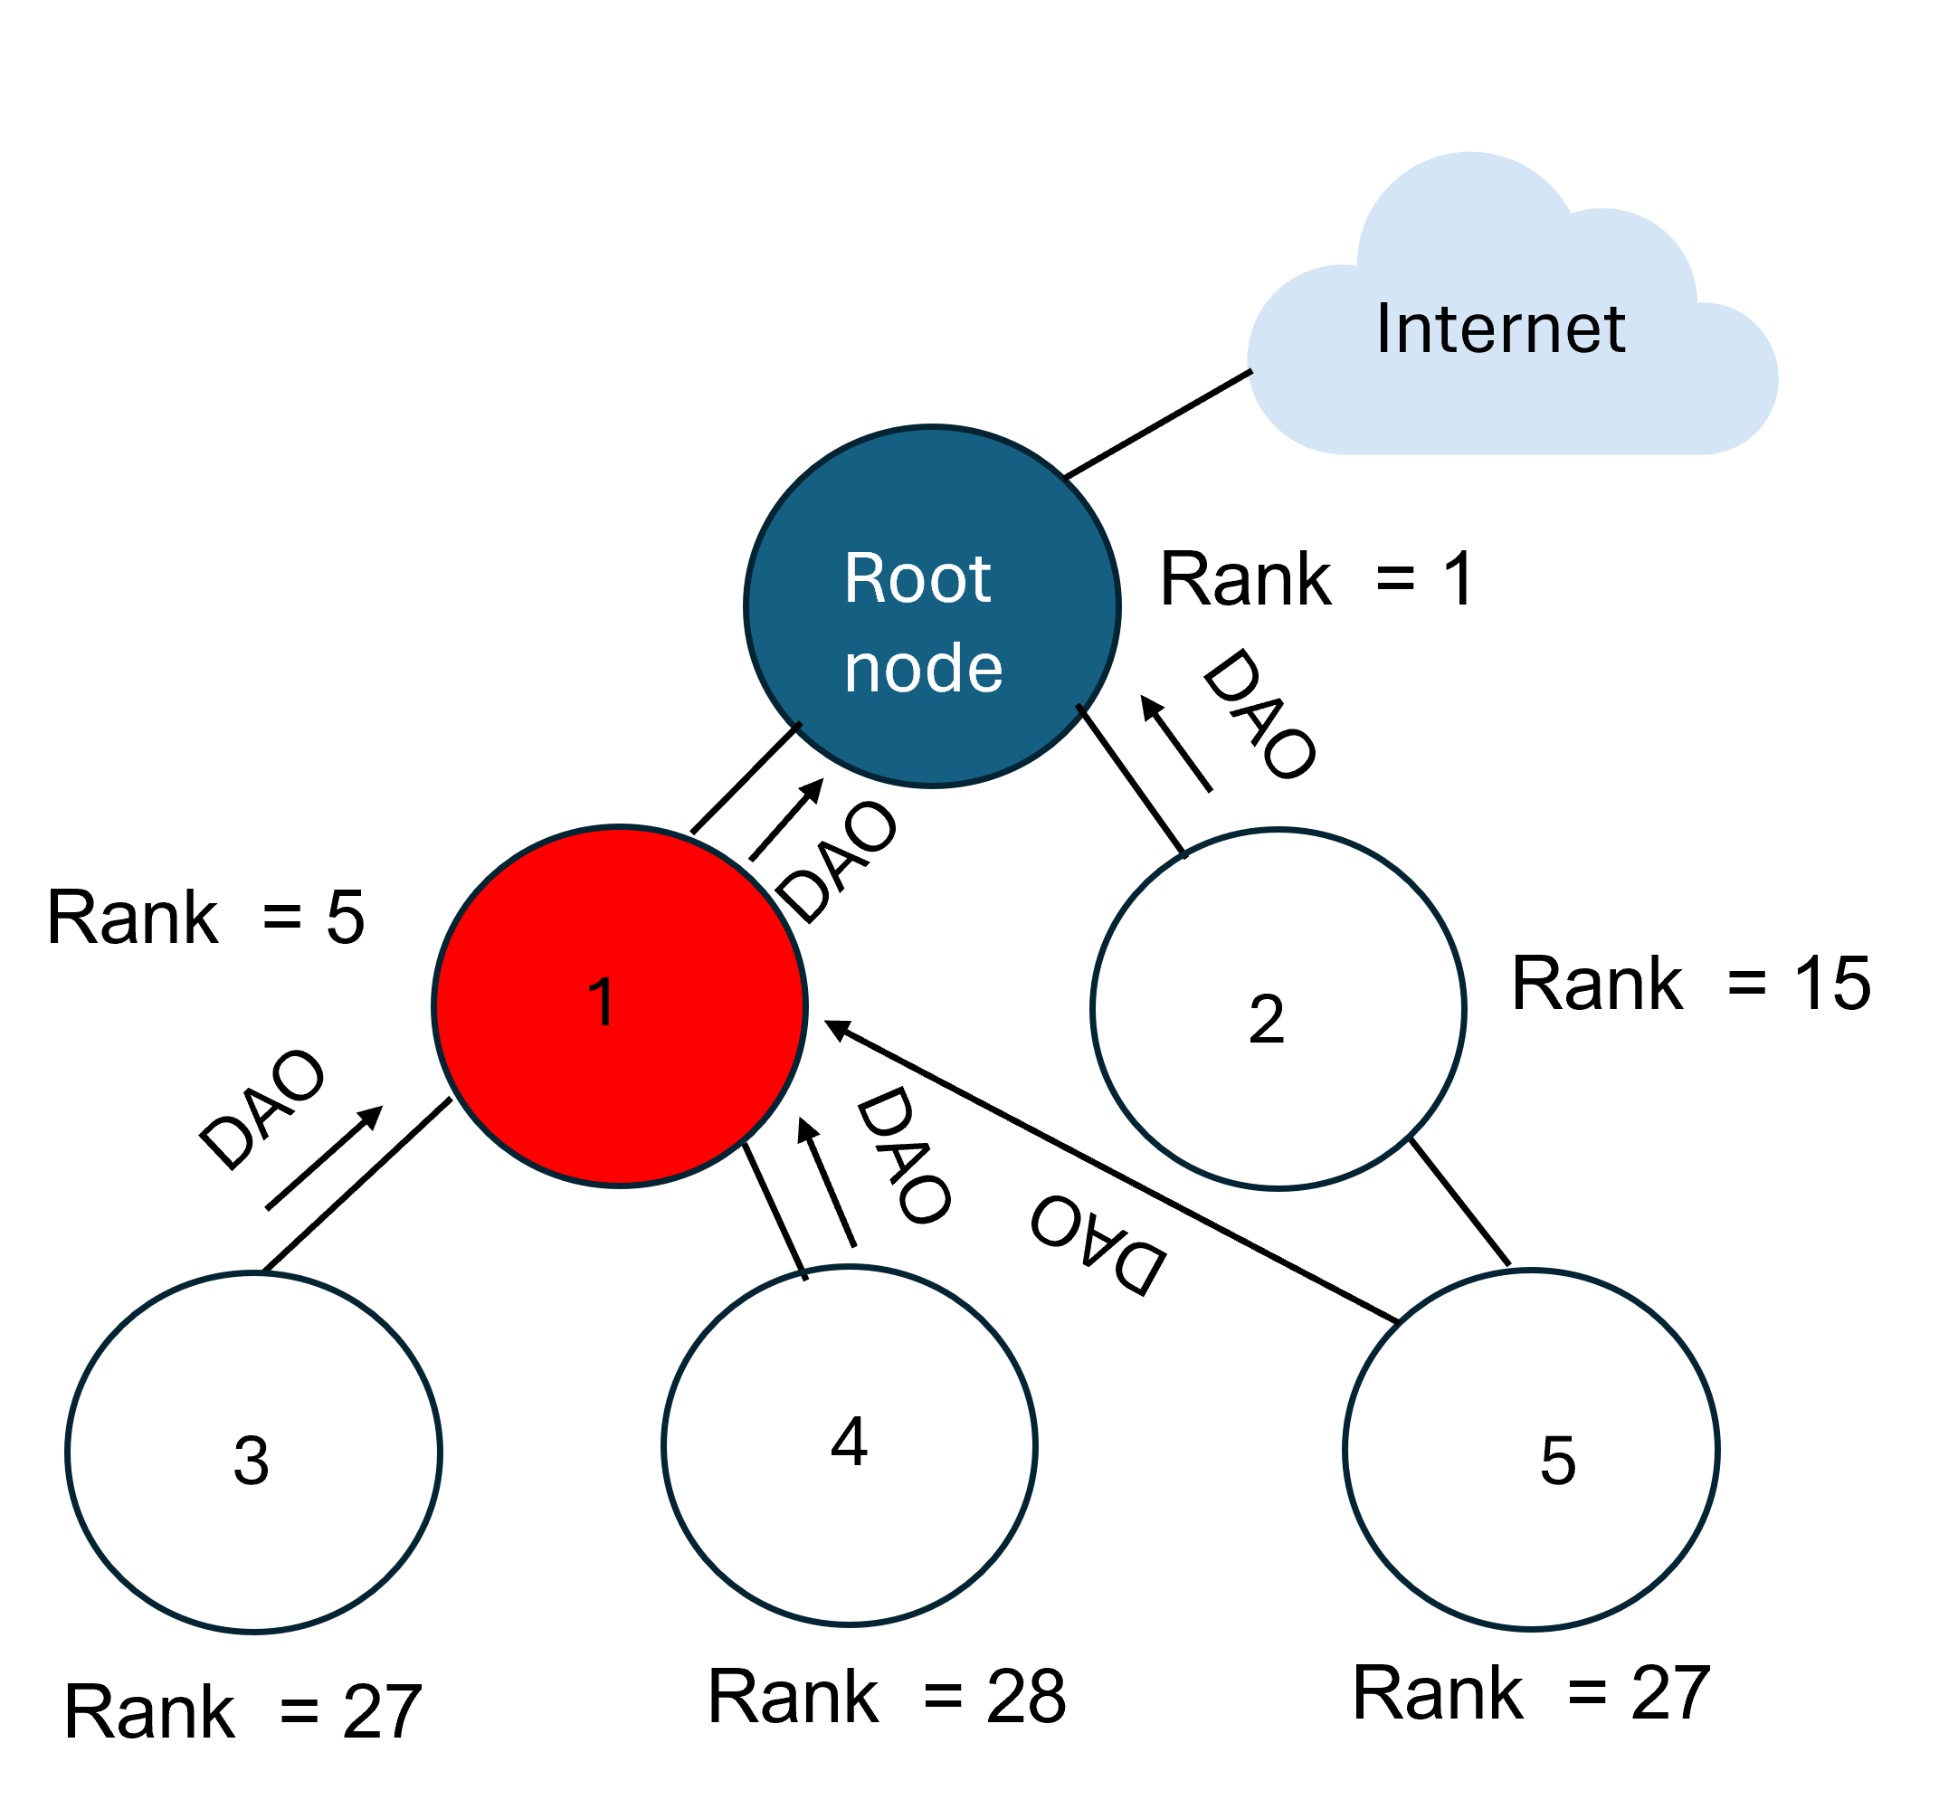
Rank attack in RPL using NetSim
Normal RPL process:
Transmitter broadcasts DIO during DODAG formation
Receiver updates parent list, sibling list, and rank
Receiver sends DAO message with route information
Malicious node behavior:
Receives DIO but doesn't update its rank
Advertises a fake (lower) rank
Other nodes update their rank based on this fake information
Attack impact:
Nodes choose malicious node as preferred parent due to lower rank
Malicious node drops packets instead of forwarding
Result: Zero network throughput
All nodes in the network choose their parent based on link quality
Nodes 3, 4, and 5 choose parent as node 1 due to its lower rank
Rehman et al., “Rank Attack using Objective Function in RPL for Low Power and Lossy Networks,” 2016, IEEE International Conference on Industrial Informatics and Computer Systems (CIICS).

Slide 10
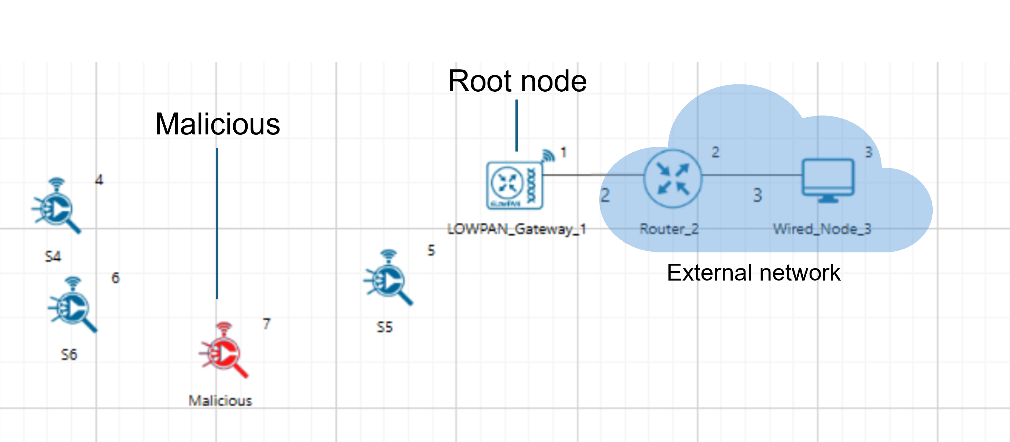
Rank attack in RPL using NetSim
Consider the scenario shown. The root node(LOWPAN Gateway) has rank 1. It sends DIO messages to Sensor 5 and Sensor 7, which are within its range.
Both Sensor 5 and Sensor 7 recognize the DODAG ID of the root node. They identify the root node as their parent.
After this, Sensor 5 and Sensor 7 transmit DAO messages to the root node. These DAO messages help to propagate destination information upward along the DODAG. Sensor 5 then updates its rank and broadcasts DIO messages.
However, Sensor 7 is a malicious node. It also updates its rank but advertises a fake, lower rank after receiving the DIO message from the root node.
Sensors 6 and 4 receive DIO messages from both Sensor 5 and Sensor 7. Due to Sensor 7's falsely advertised lower rank, Sensors 6 and 4 choose Sensor 7 as their preferred parent.
After selecting Sensor 7 as their parent, Sensors 6 and 4 send DAO messages and data packets to Sensor 7.But instead of forwarding the data packets, Sensor 7 drops them.
The network topology in IoT using RPL Protocol,
Pathloss Model: Log Distance, Pathloss Exponent: 2

Slide 11
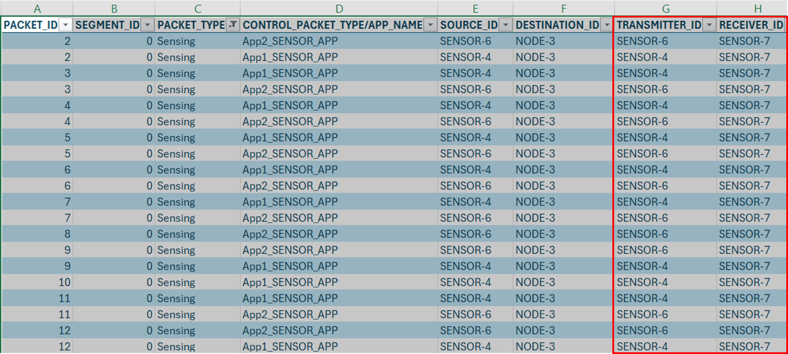
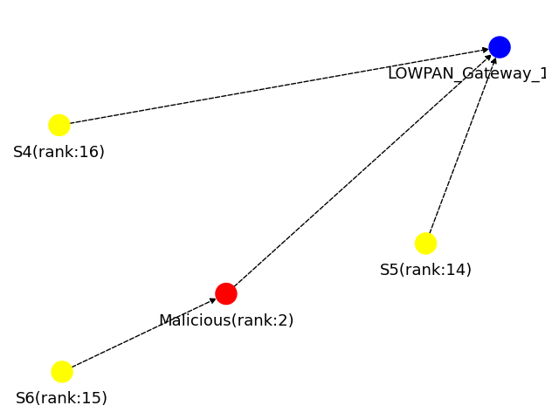
Rank attack in RPL using NetSim
The results can be observed in the Results window, showing that the network has zero throughput.
Users can also observe Packet trace that after Sensor 7 receives packets, it does not forward them, resulting in no data packet transmission from Sensor 7.
Additionally, users can generate the DODAG visualizer using Python and MATLAB utilities. In the DODAG, it can be observed that Sensor 6 and Sensor 4 have chosen Sensor 7 as their parent.
The packet trace shows that packets from Sensor-4 and Sensor-6 are received by Sensor-7, but Sensor-7 is not transmitting packets.
Throughput for the two applications is zero because the malicious sensor is collecting all the packets
The DODAG visualizer shows that Sensor-6 and Sensor-4 are choosing Sensor-7 as a parent node.

Slide 12
Training

Slide 13
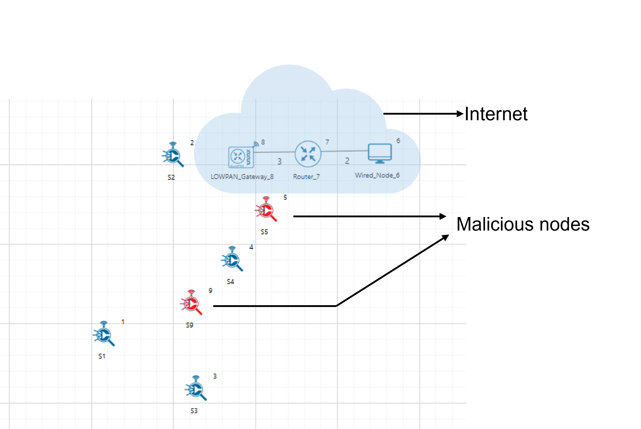
Attack scenarios - Training data generation
Created 8 scenarios with varying node counts (6 to 39)
Malicious node count: 2, 4, 5, 6, 8, 10, 12, and 14
Simulations run with 3 random seeds for each scenario
Enabled packet trace for all scenarios
Used a python script to calculate the number of DAO, DIO, and data packets received by each sensor from packet trace.
Feature Extraction
DAO Sent
DAO Received
DIO Sent
DIO Received
Data Packets Received
The network topology in IoT using RPL Protocol with 2 malicious nodes

Slide 14
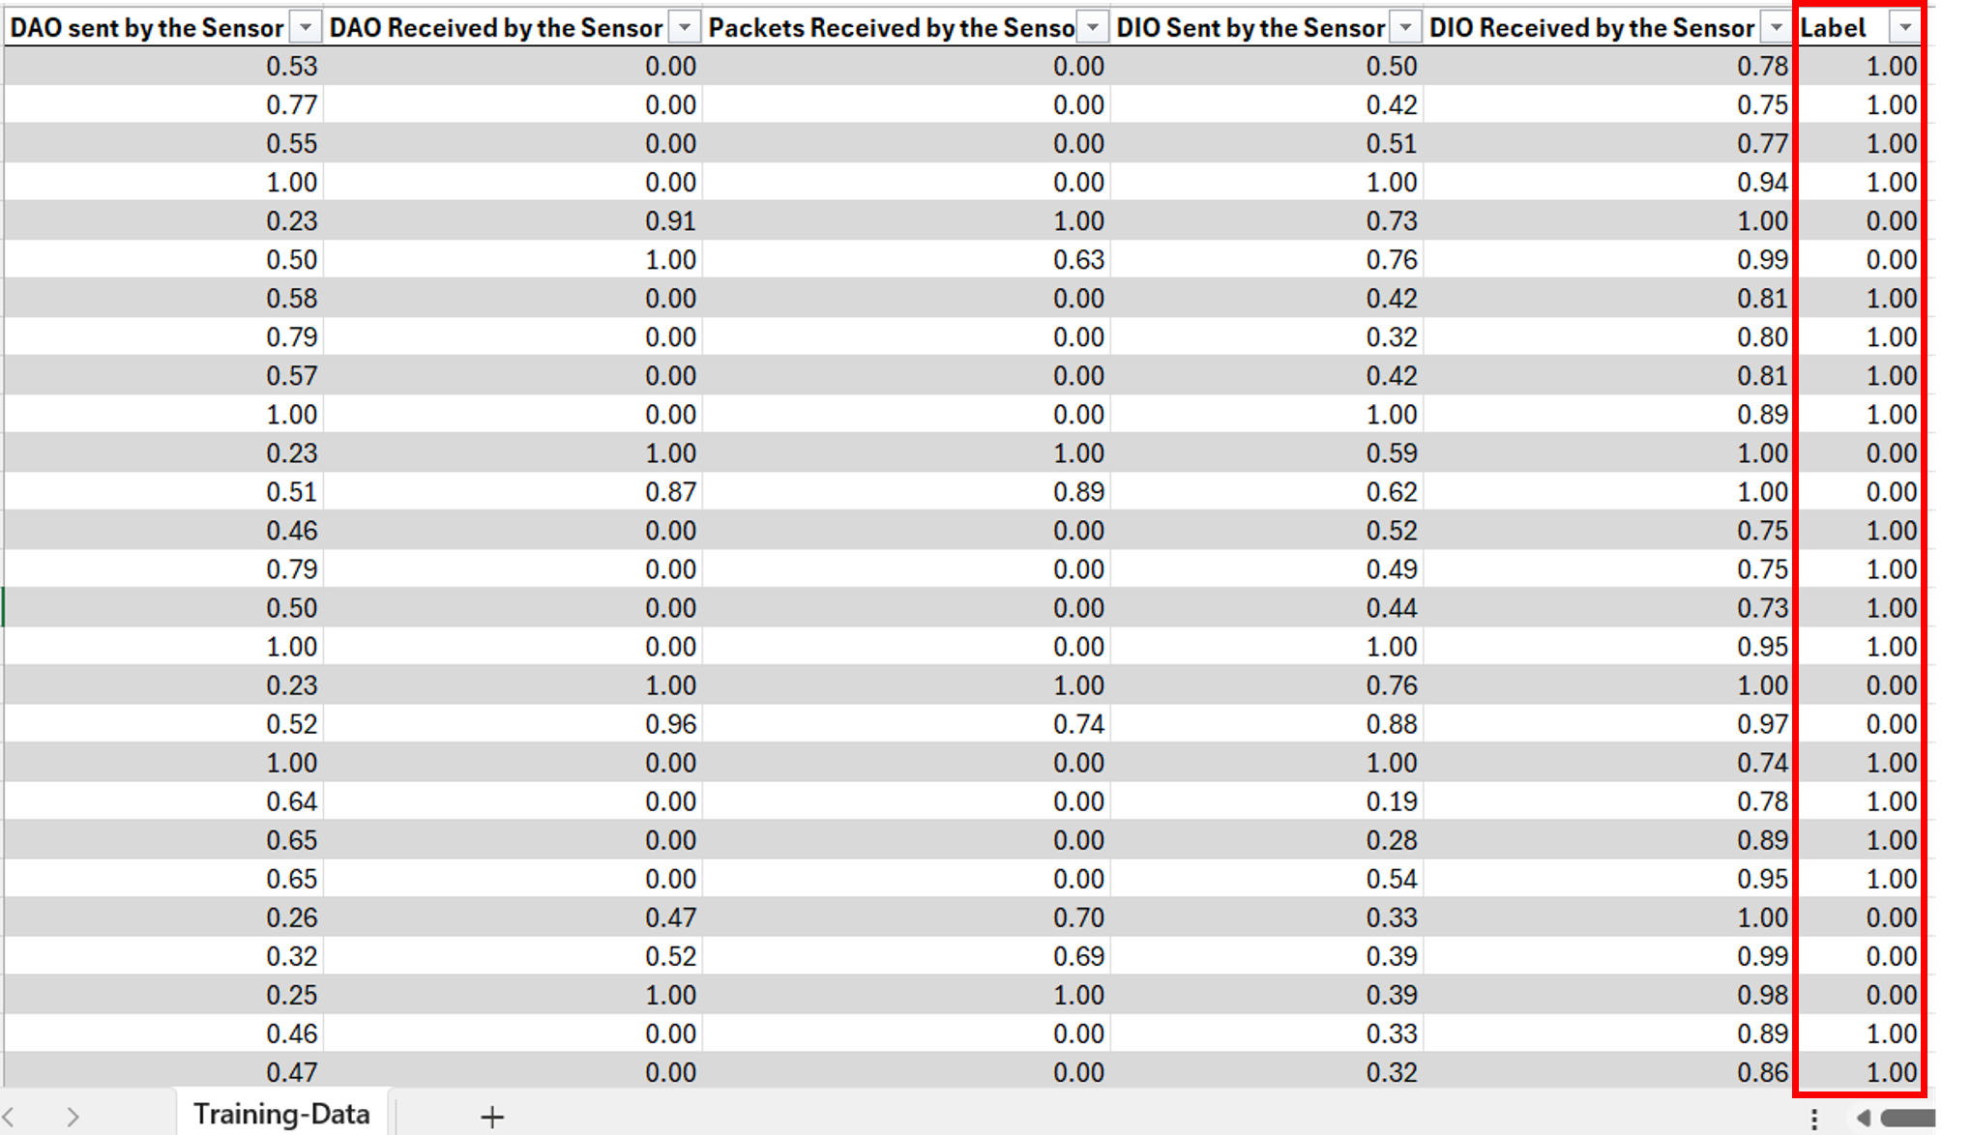
Data processing and Feature Visualization
Data extraction from packet trace to Excel using Python script
Total dataset: 534 sensors, 5 features each
Feature normalization process:
Calculate max value for each feature across all sensors
Divide each sensor's value by the max to get 0-1 range
Manual labeling: 1 for non-malicious, 0 for malicious
We label the sensors based on the features

Slide 15
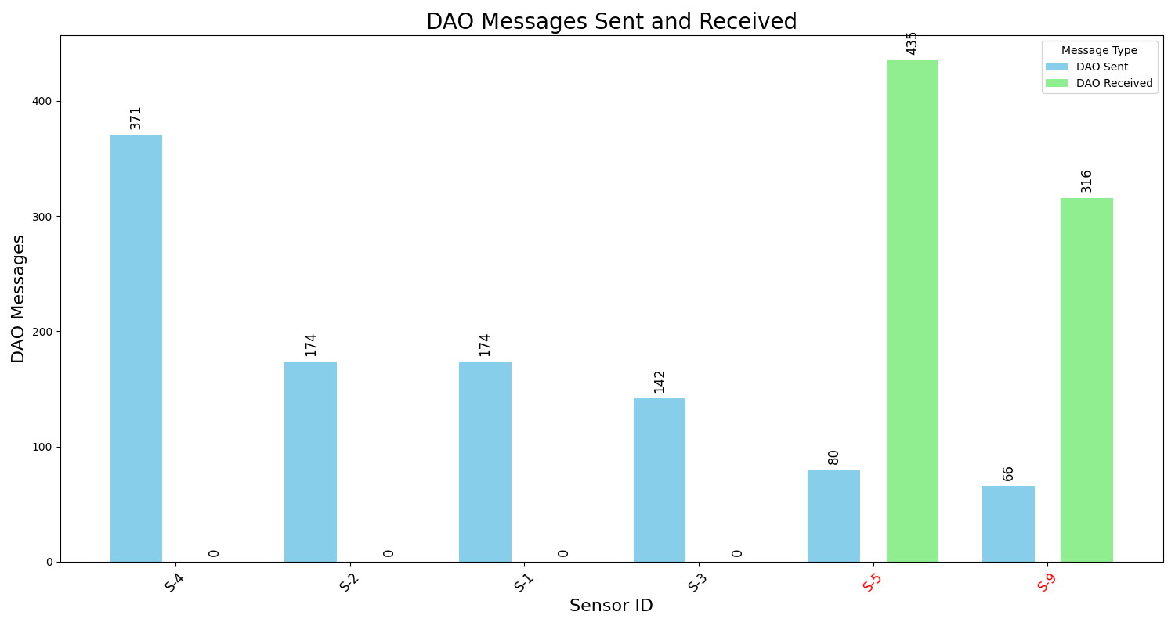
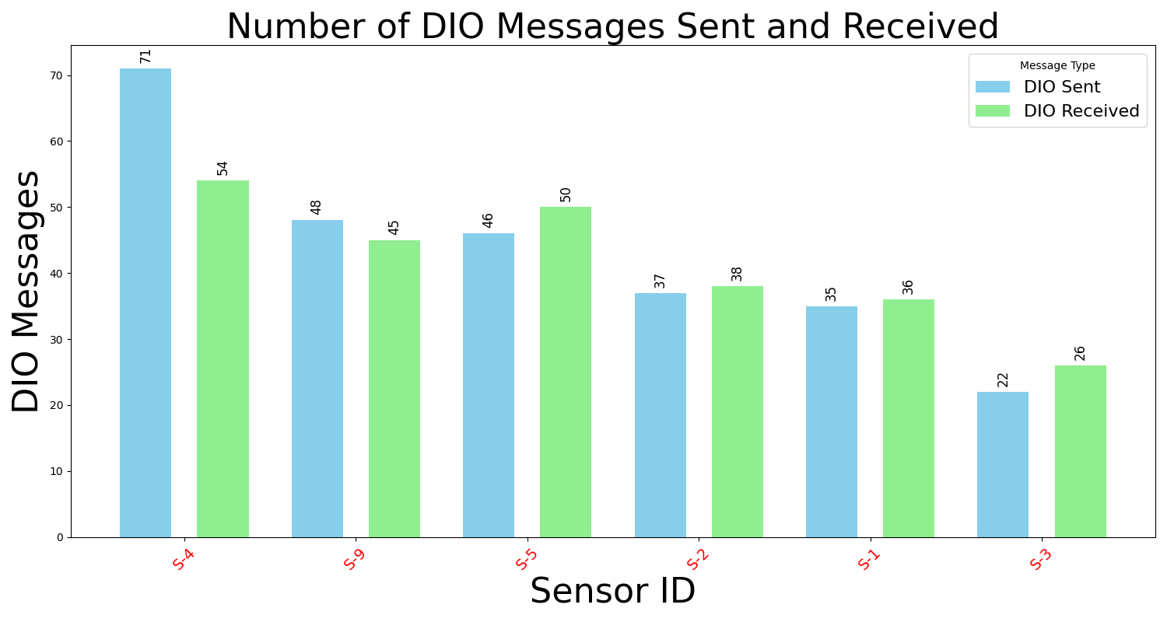
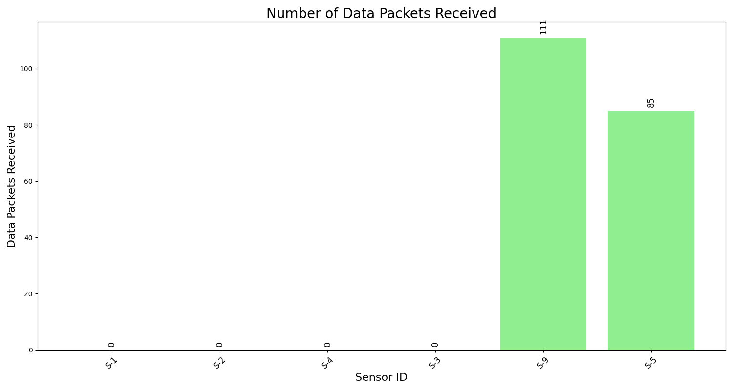
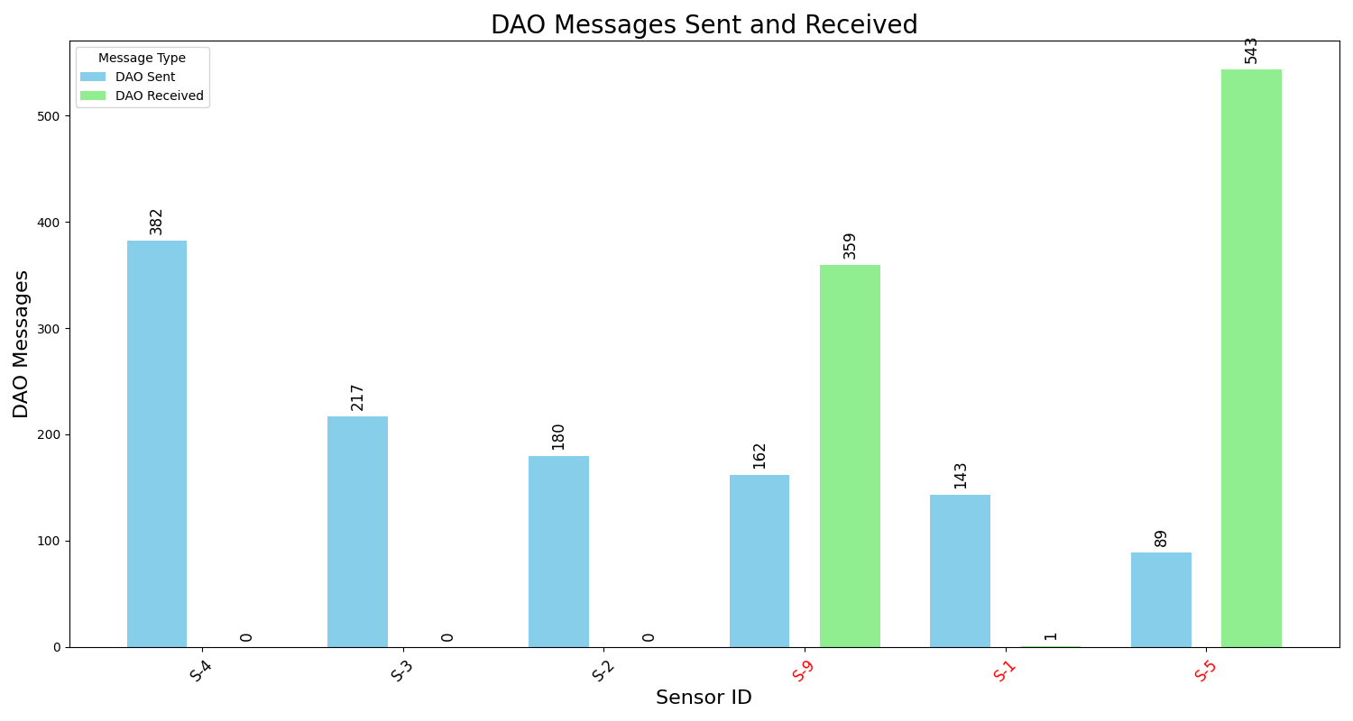
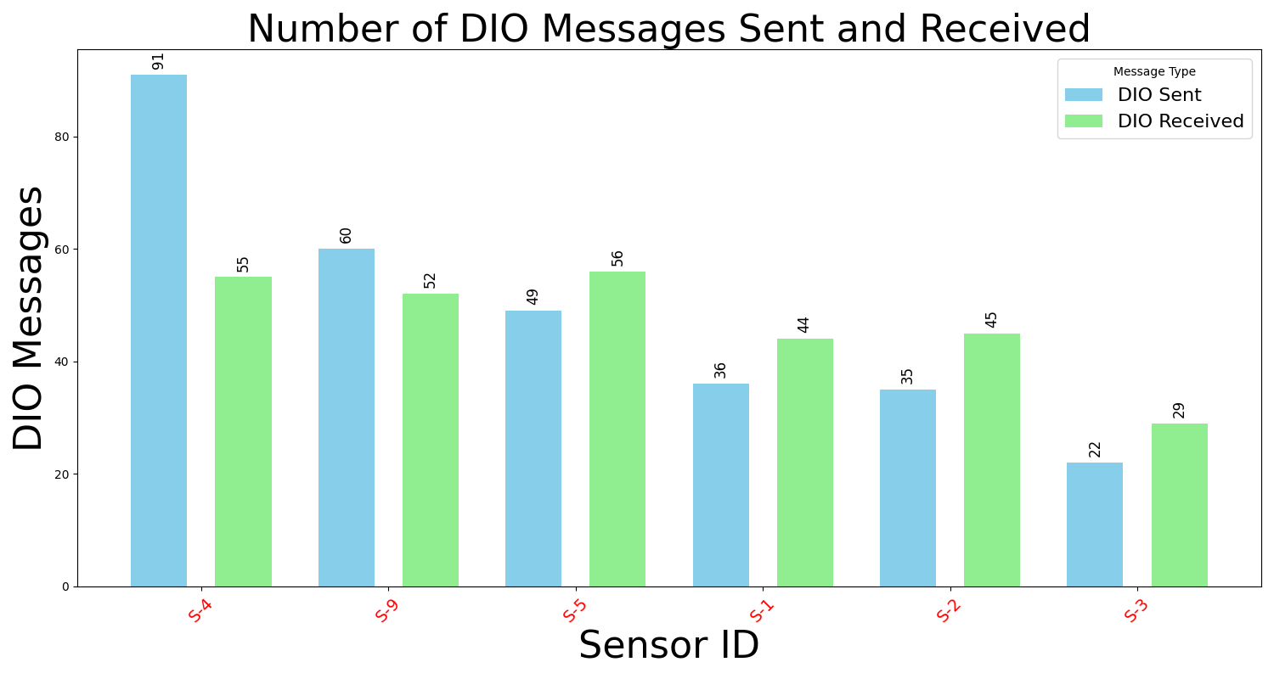
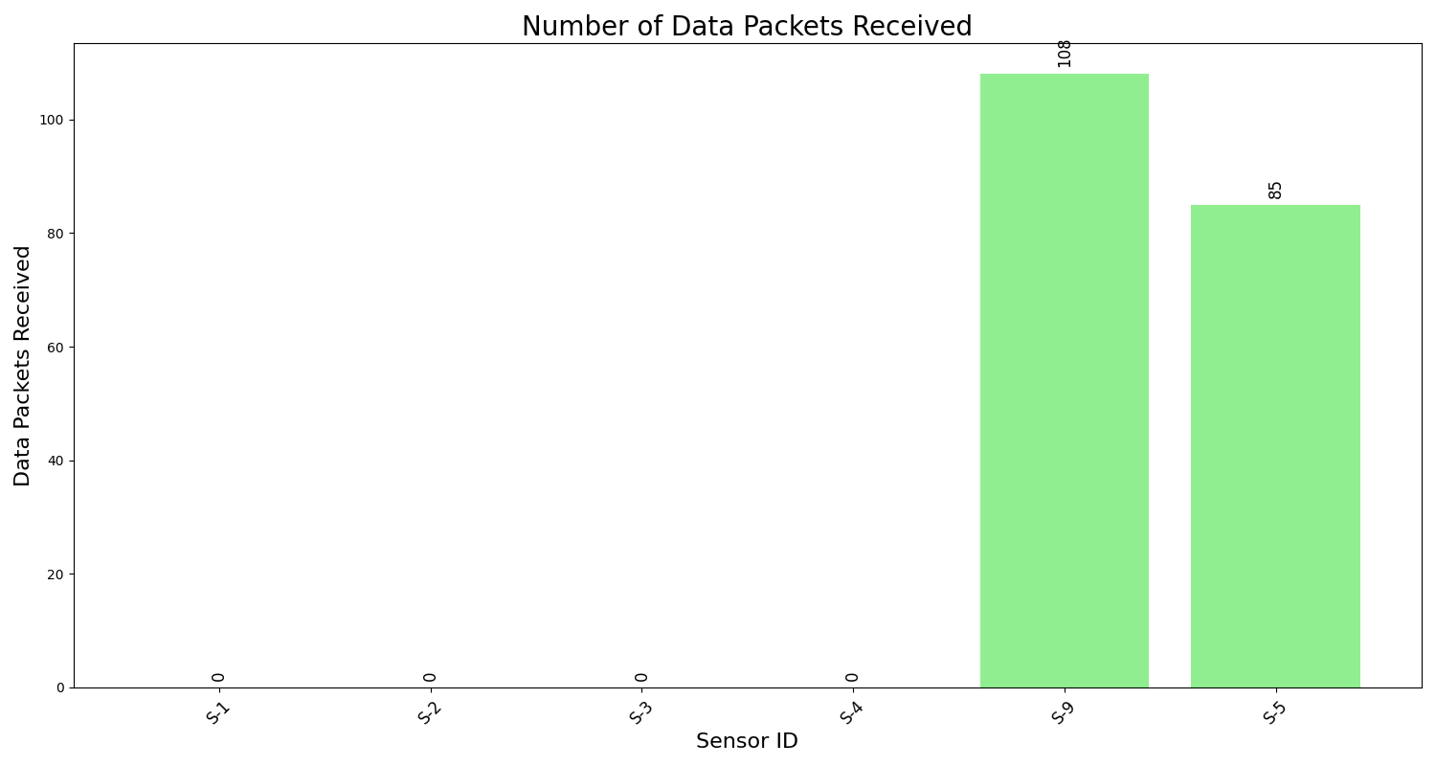
Feature visualization: 2 malicious nodes; 3 runs, each with a different random seed

Slide 16
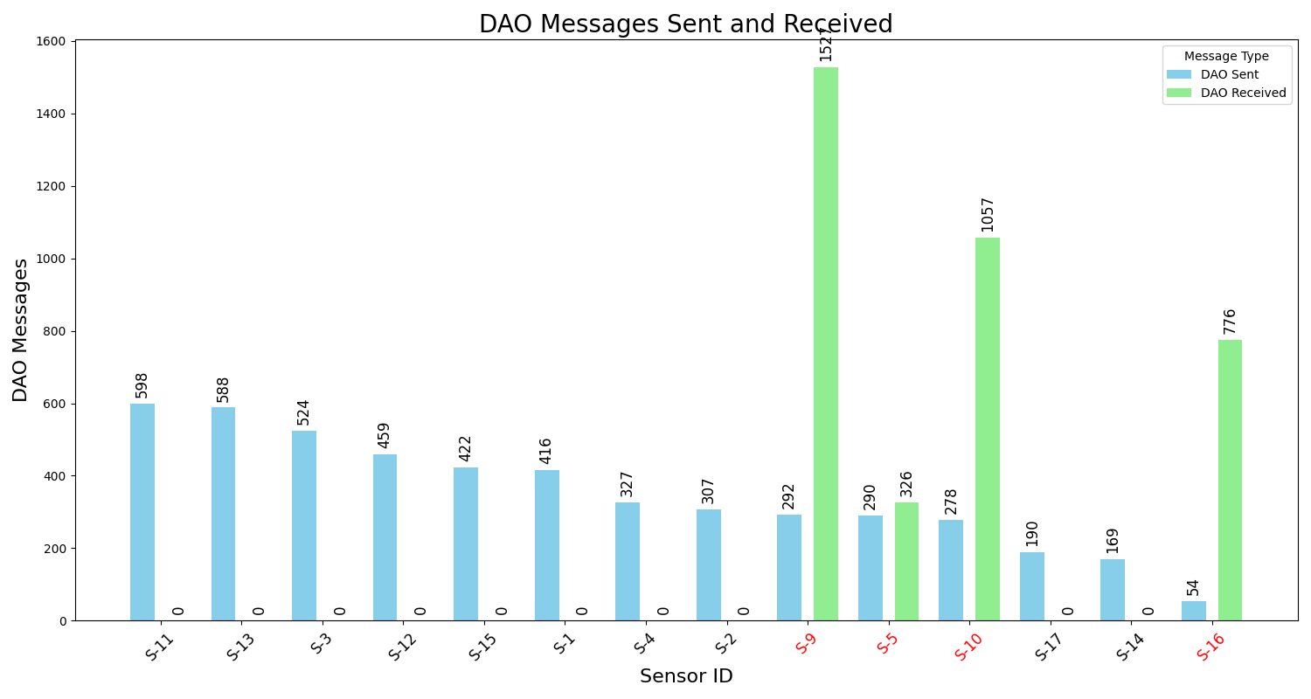
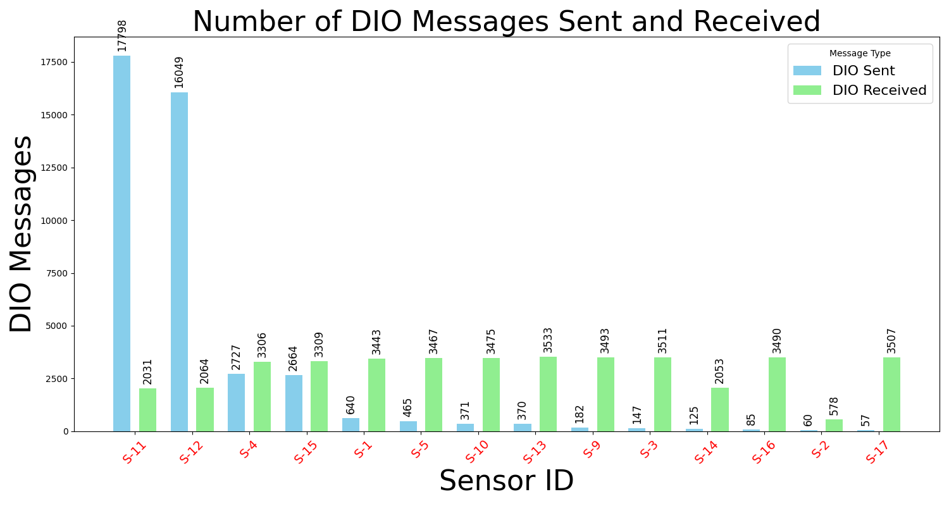
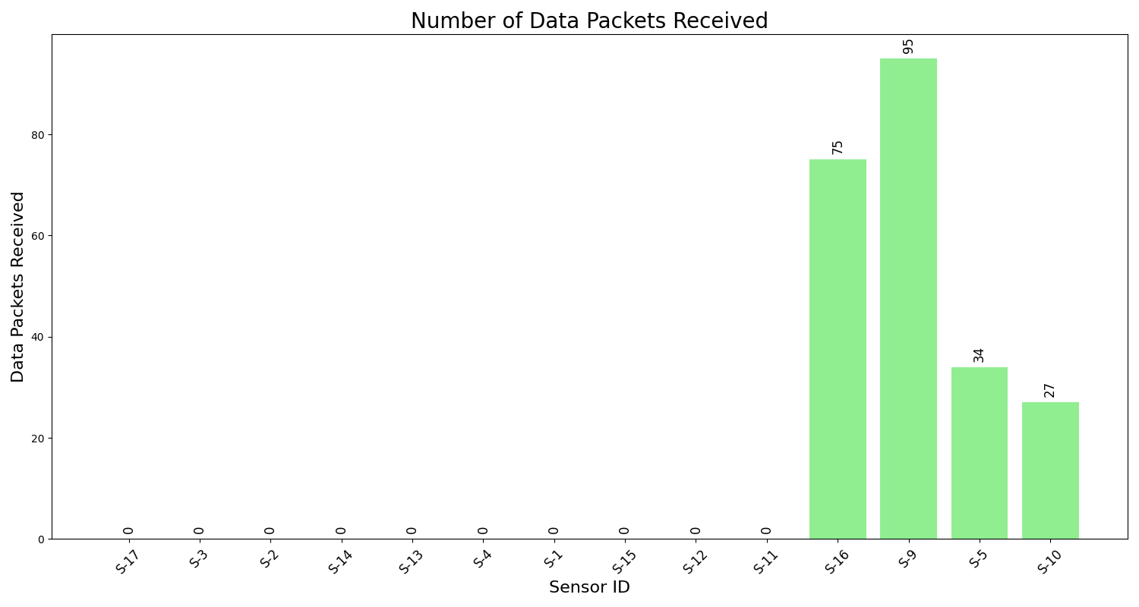
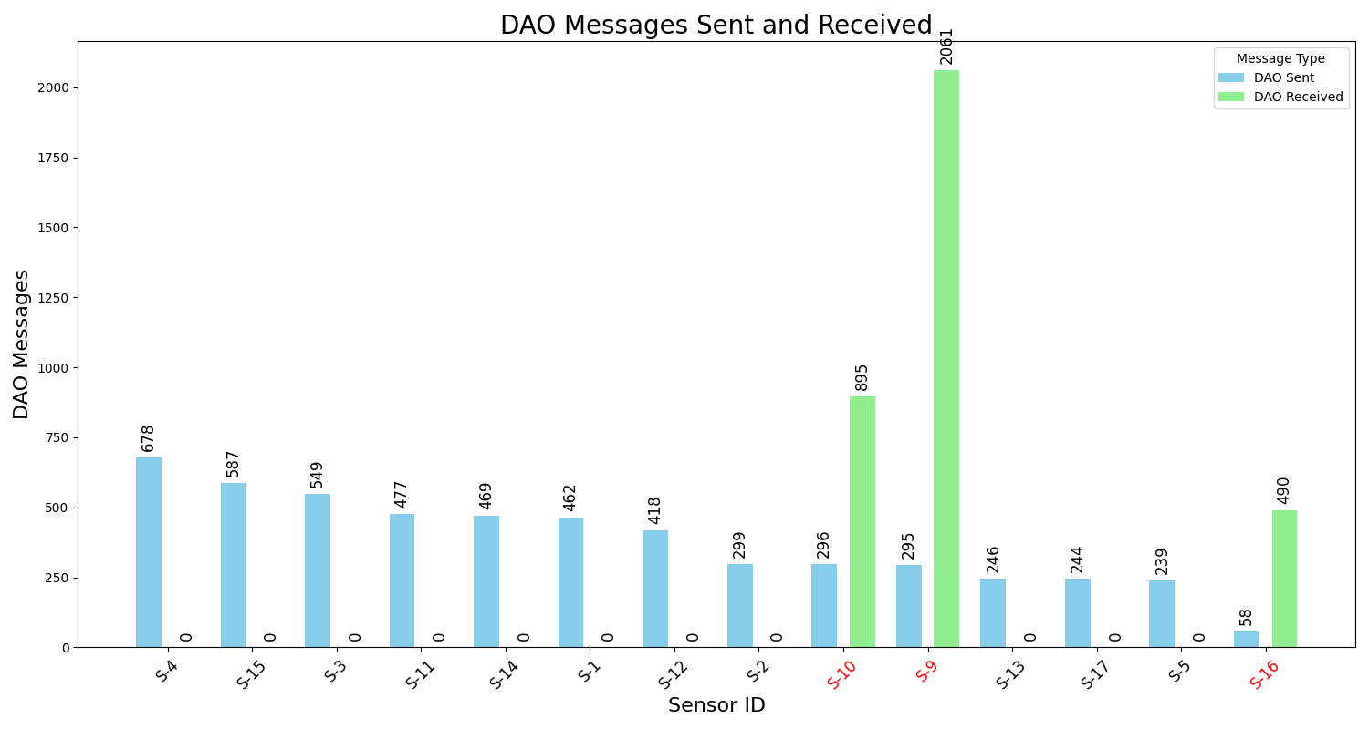
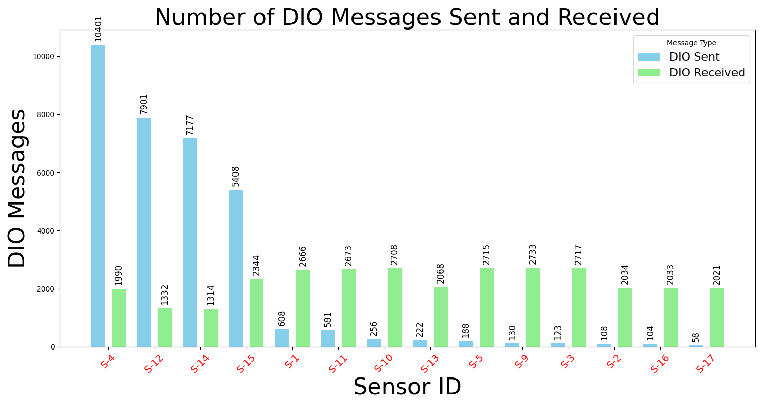
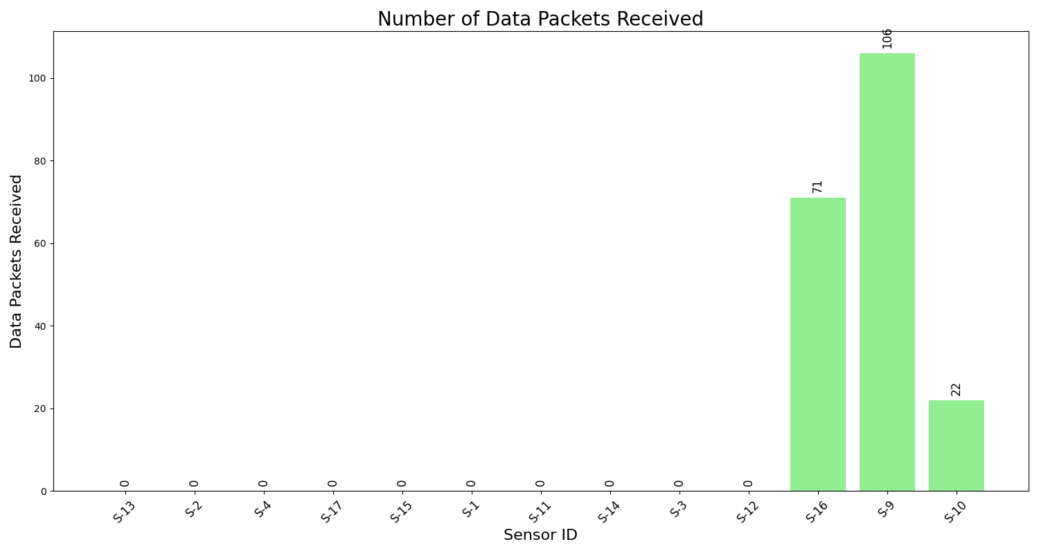
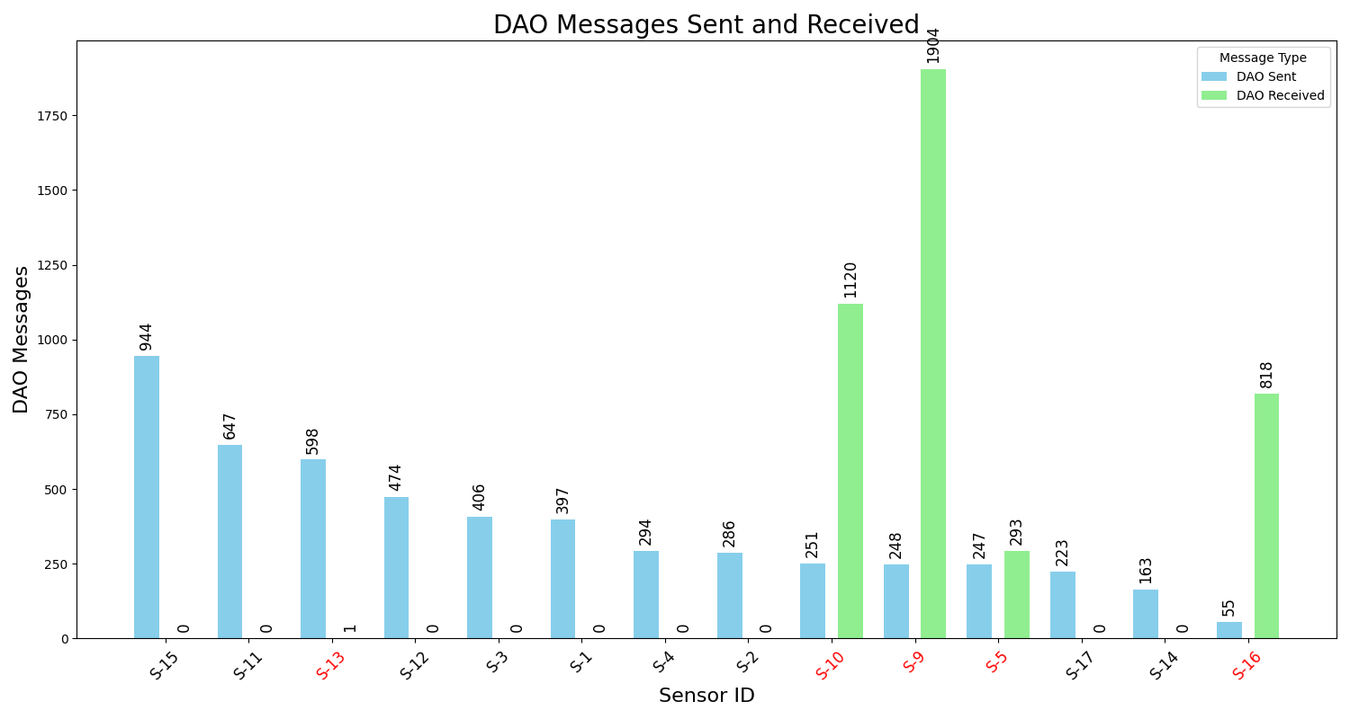
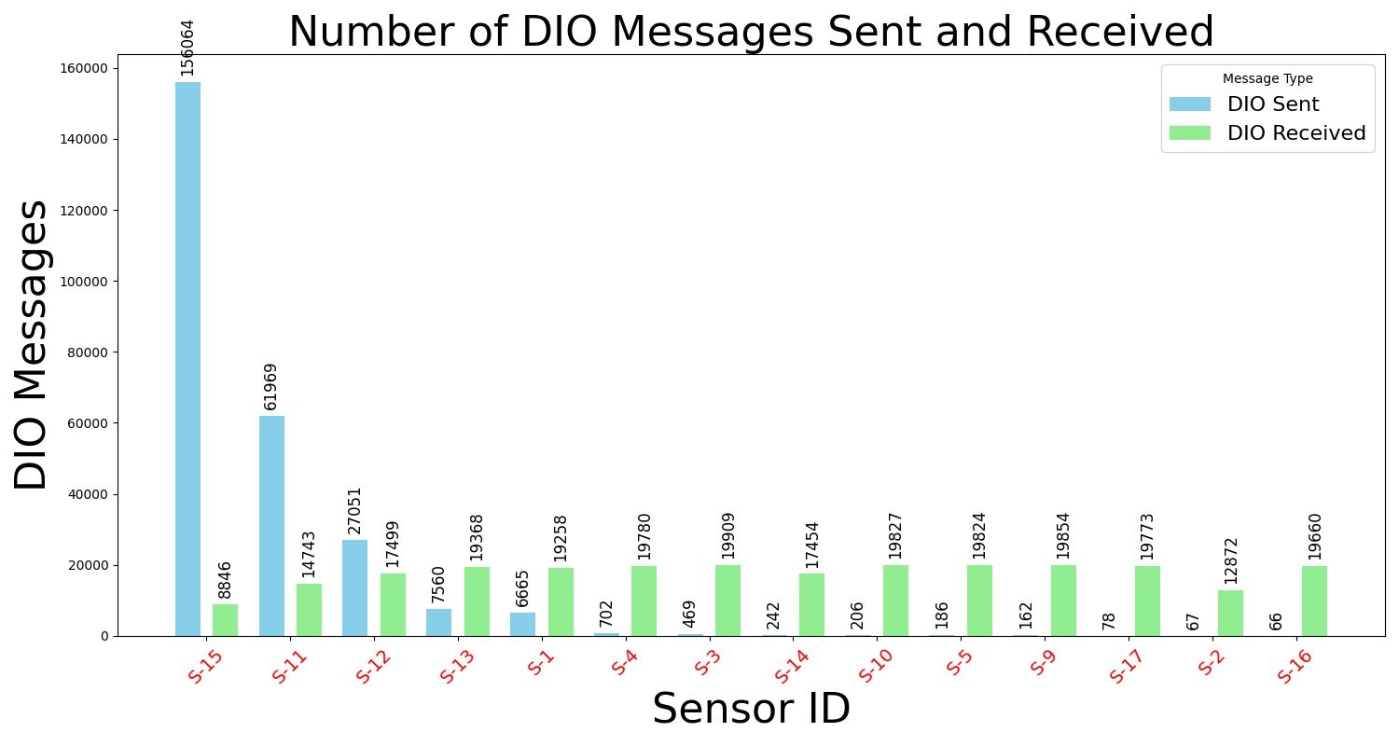
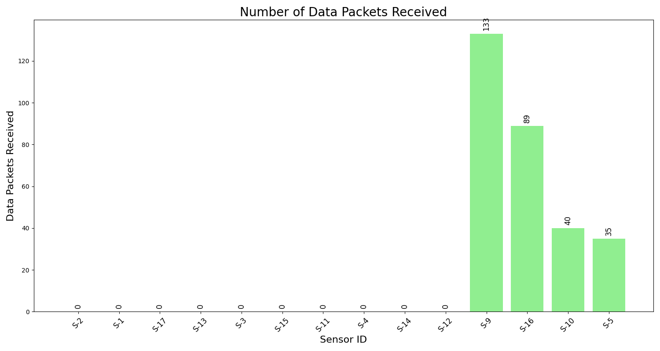
Feature visualization: 4 malicious nodes; 3 runs, each with a different random seed

Slide 17
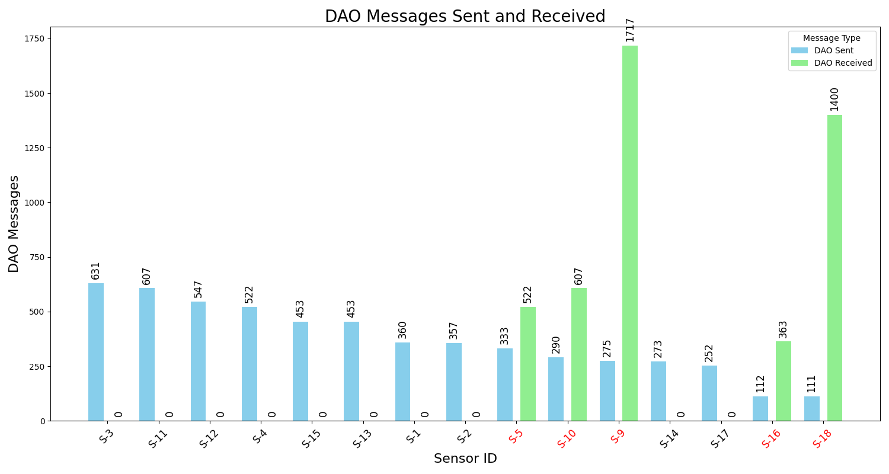
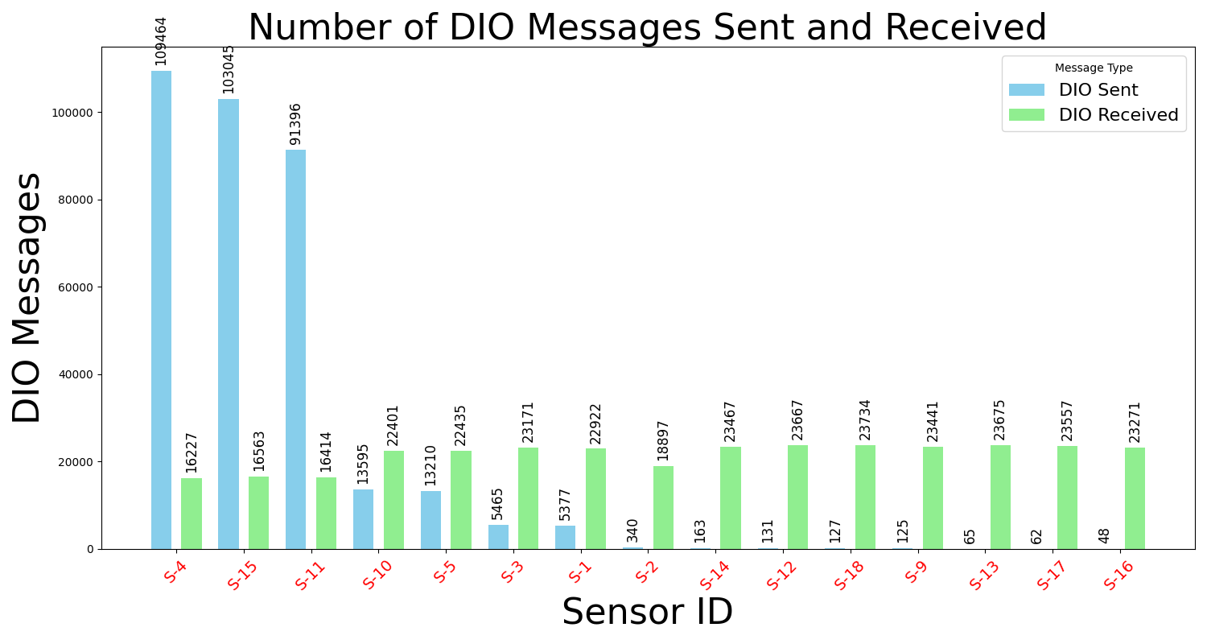
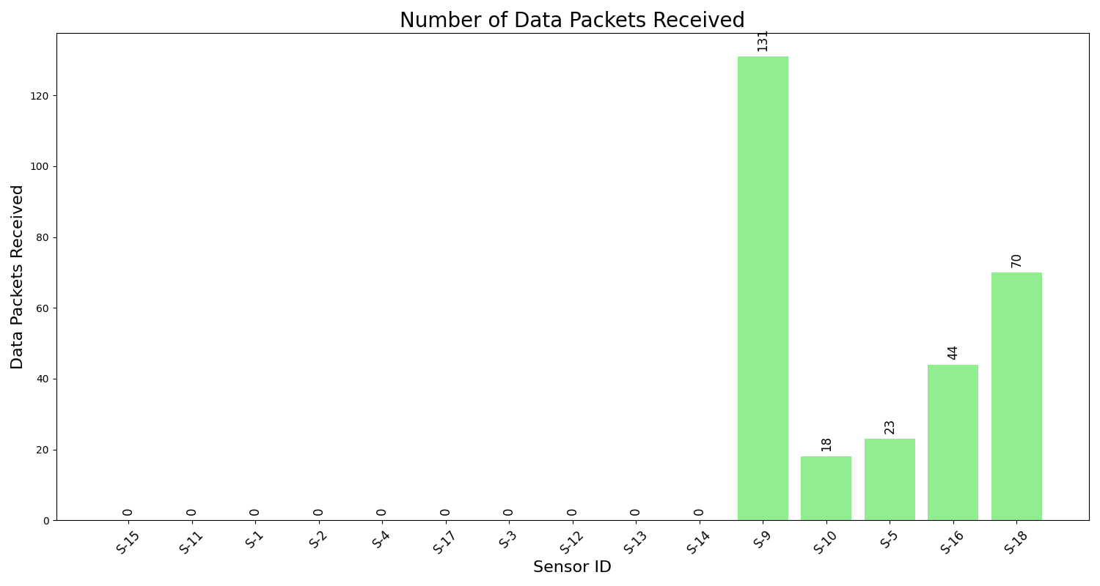
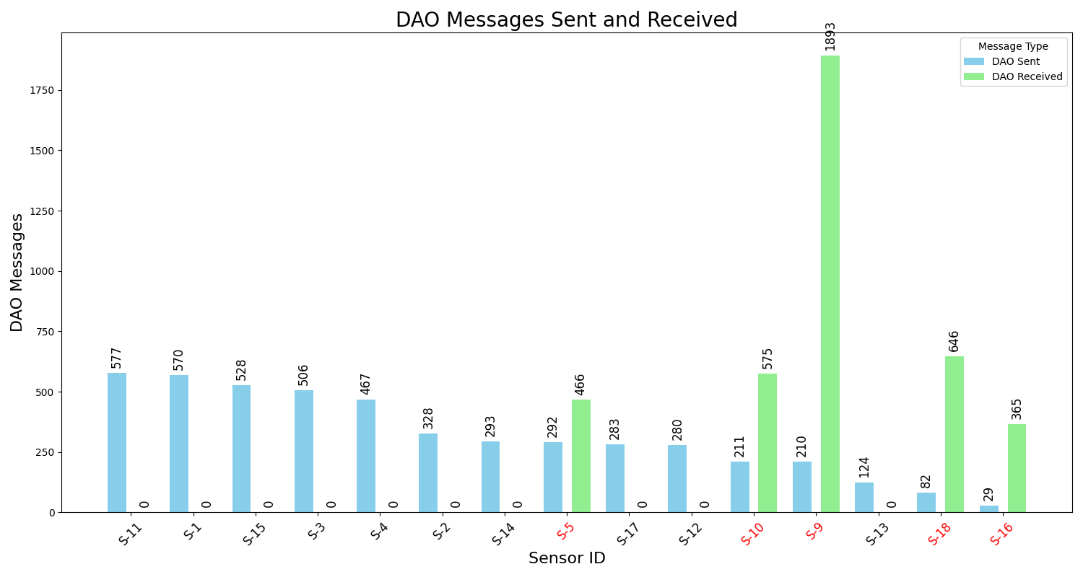
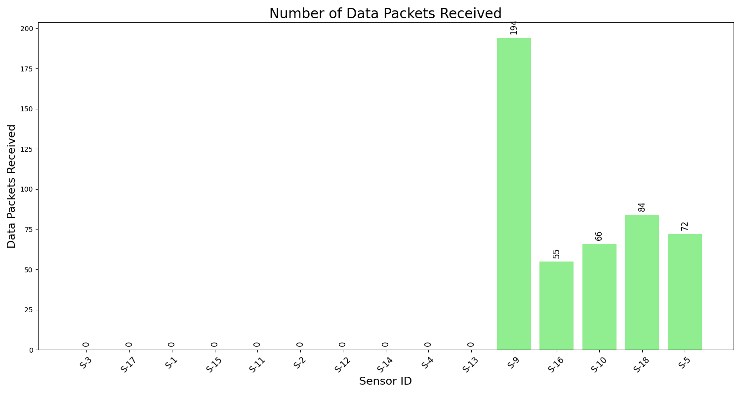
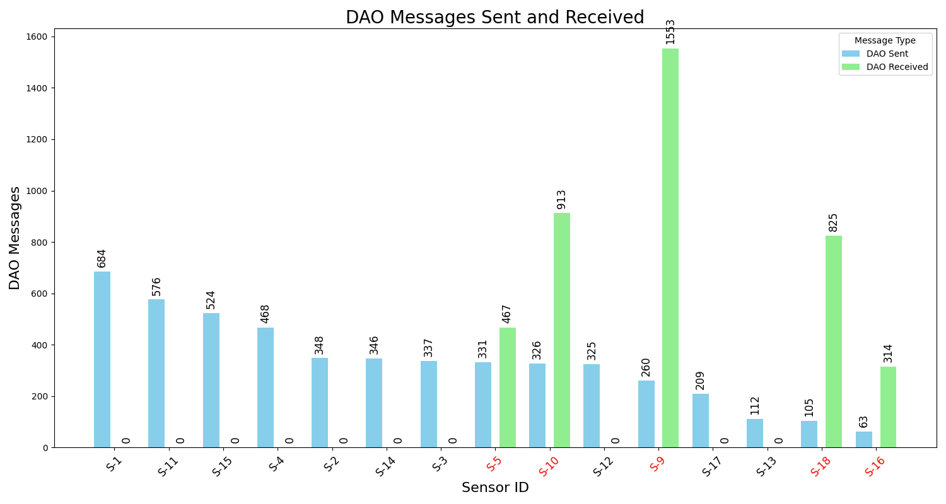
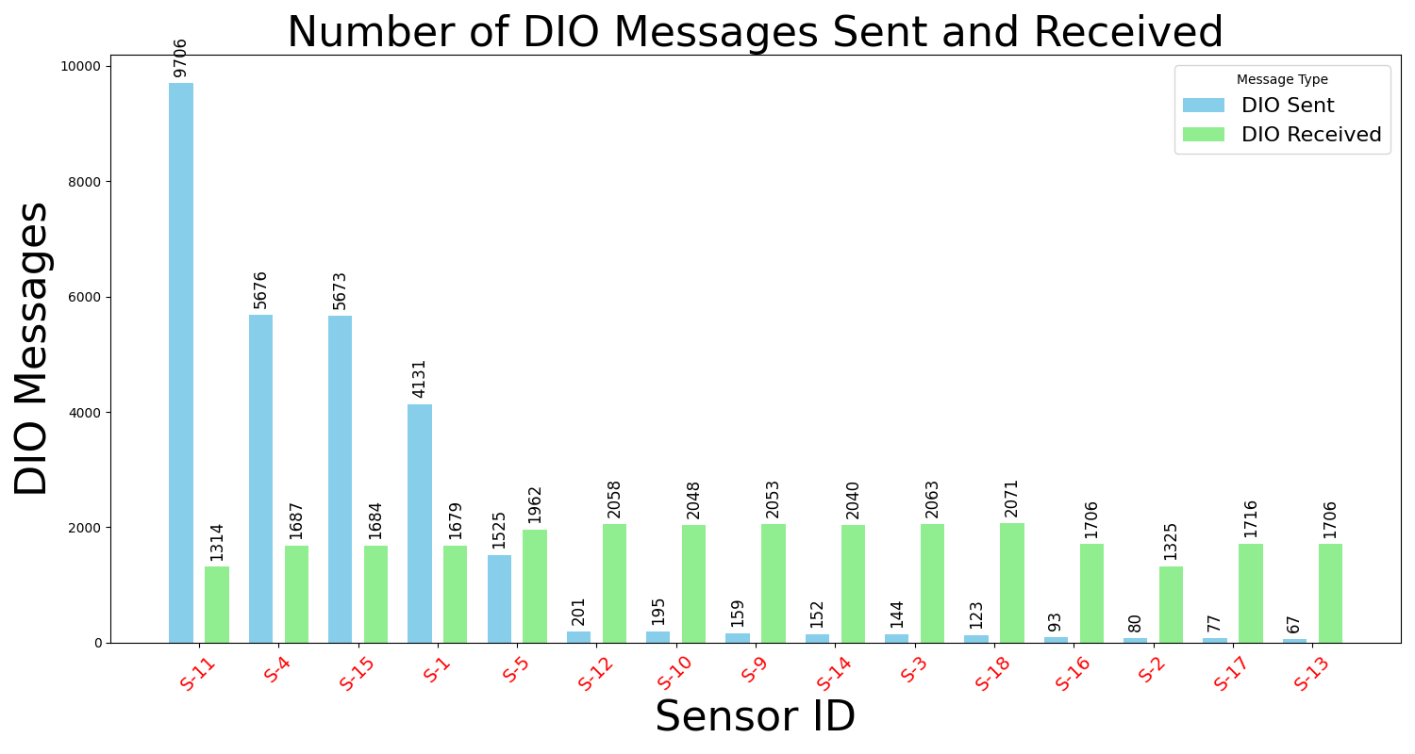
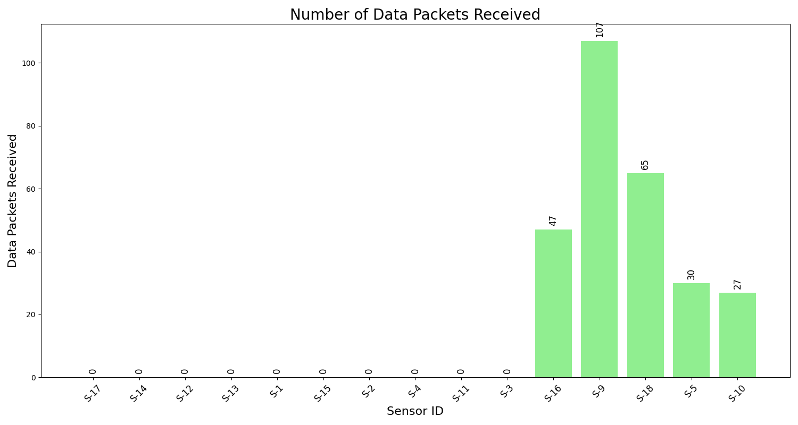
Feature visualization: 5 malicious nodes; 3 runs, each with a different random seed

Slide 18
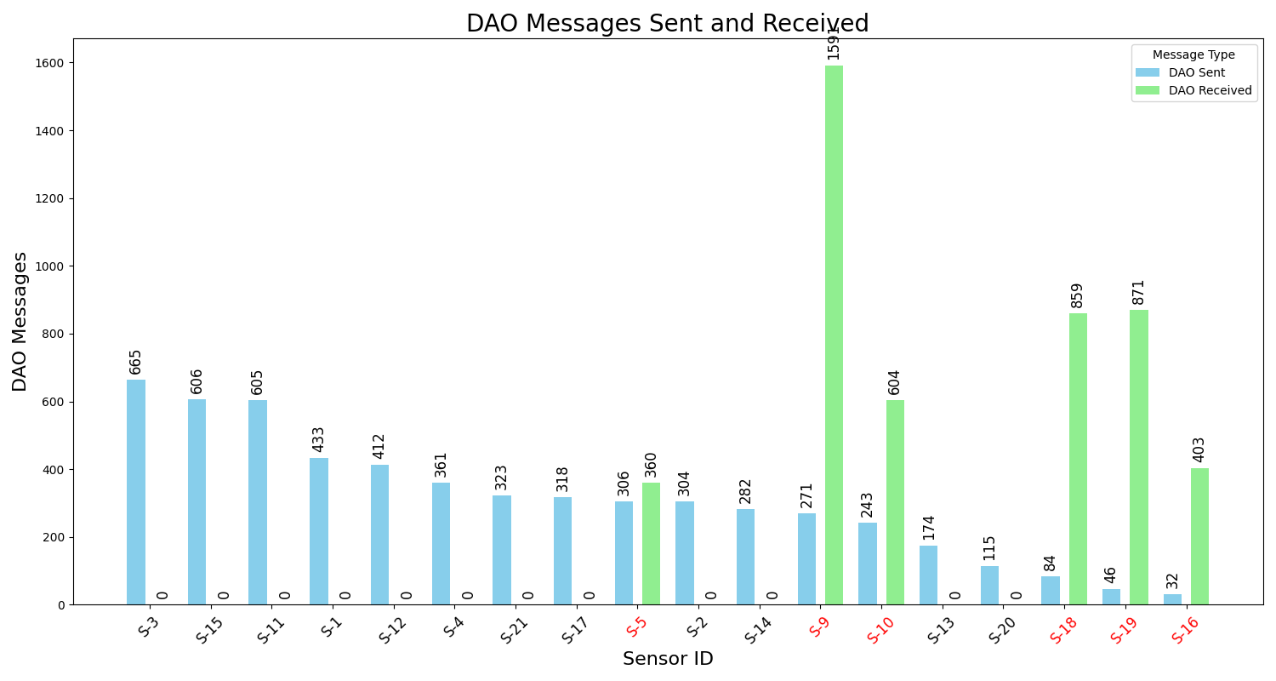
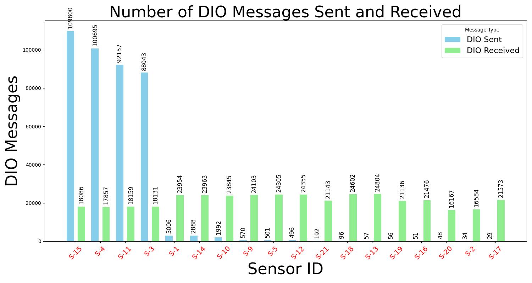
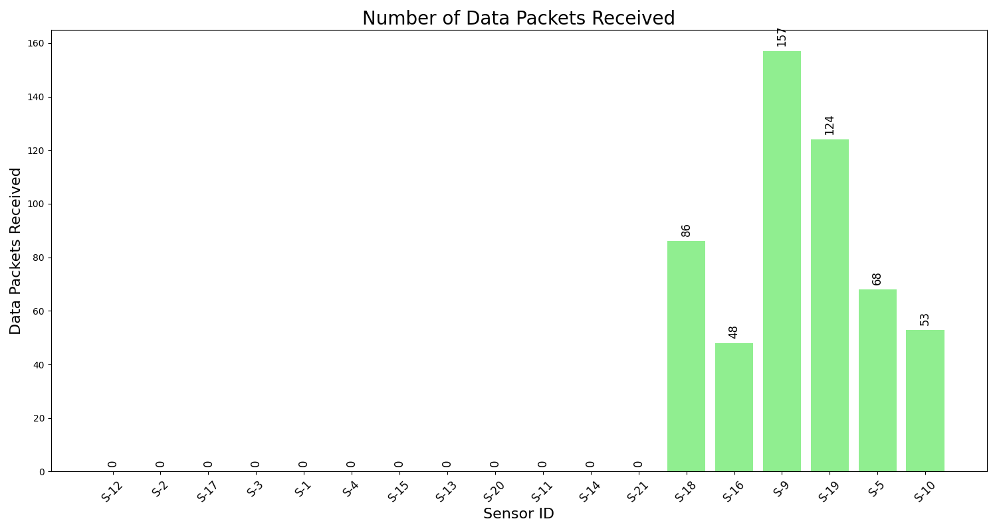
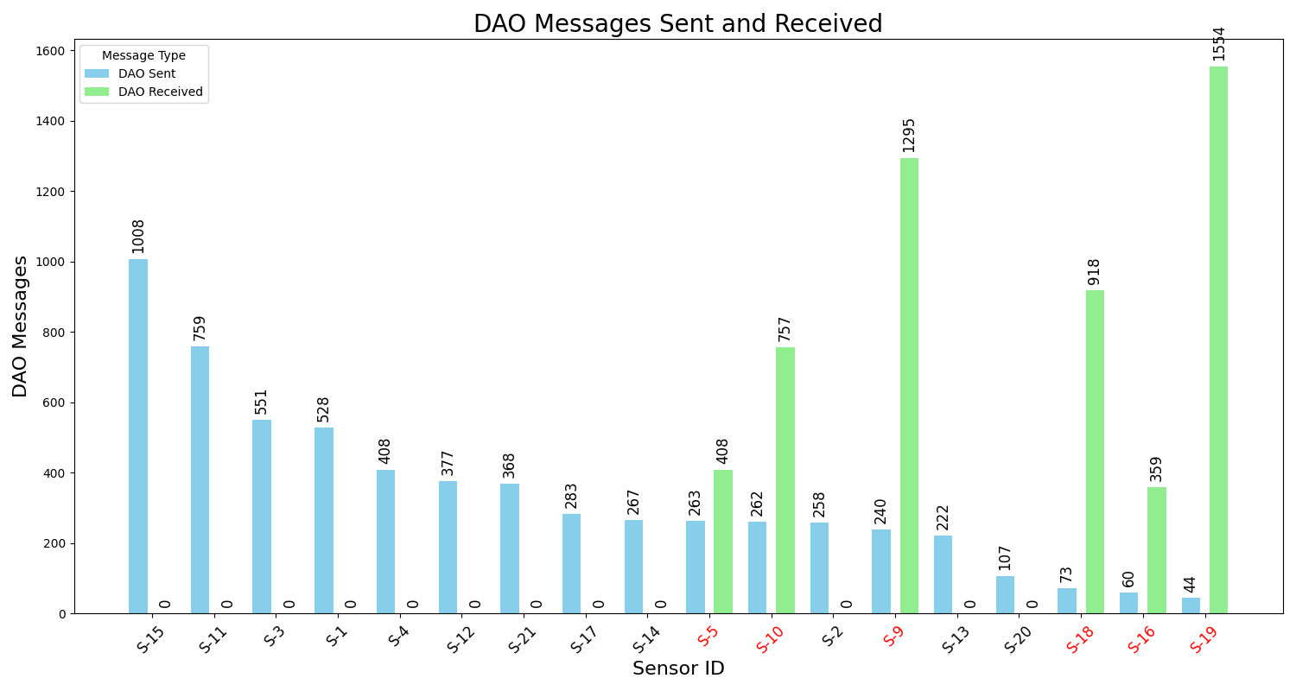
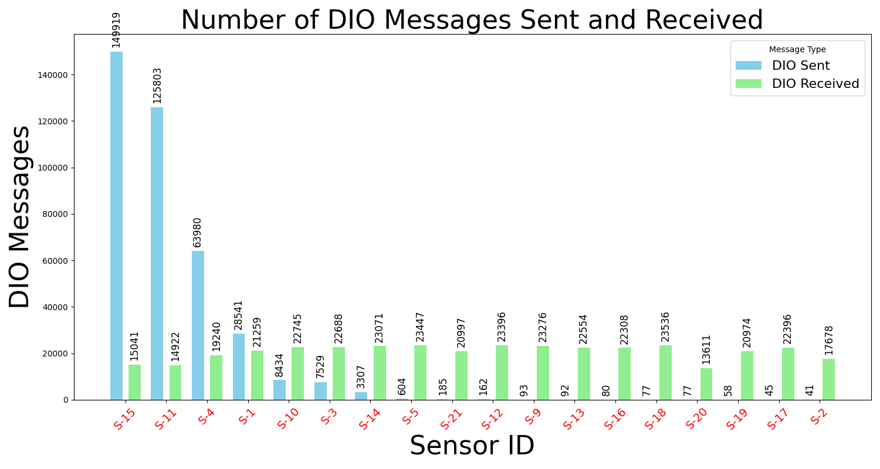
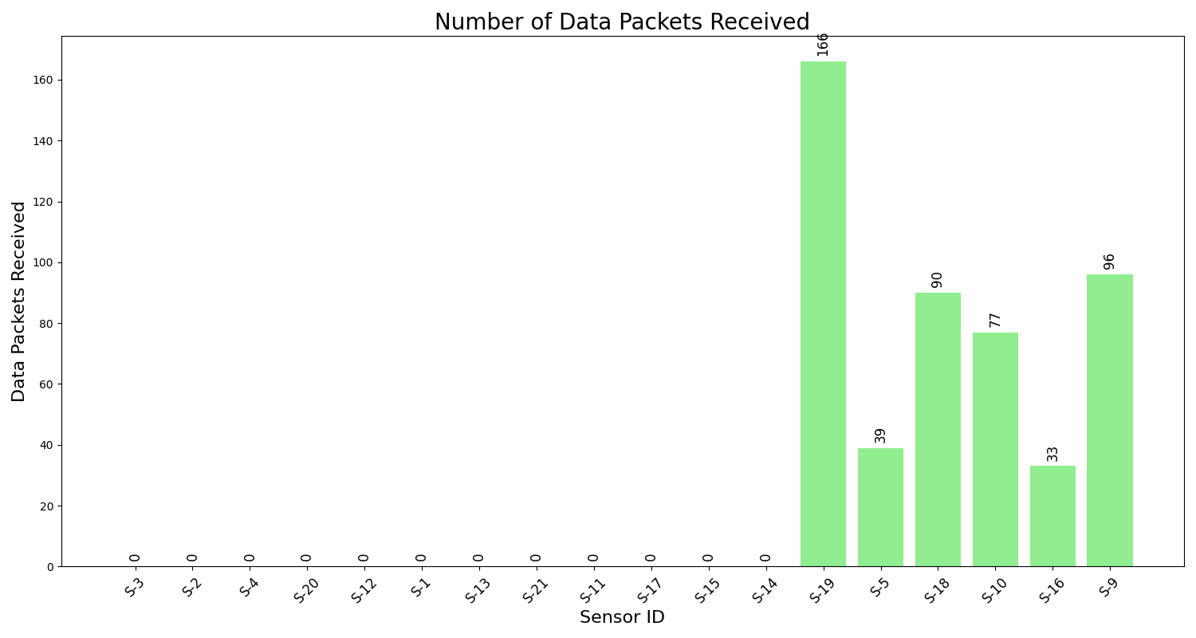
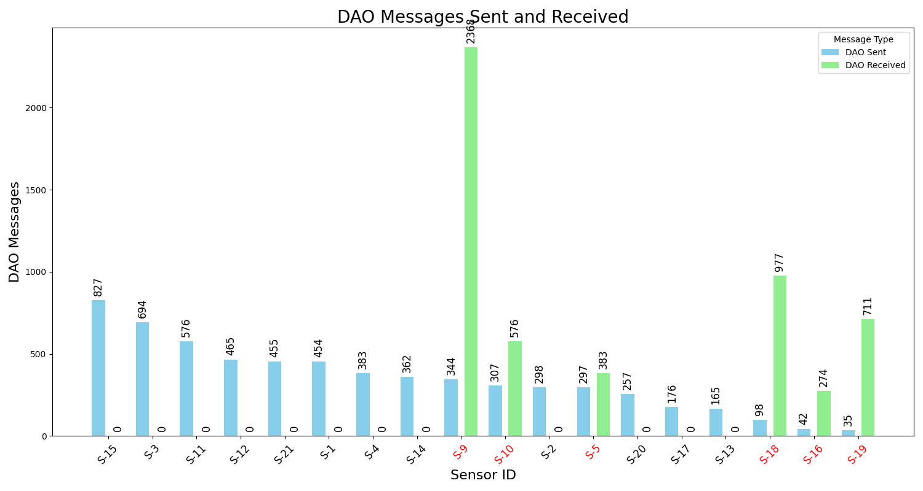
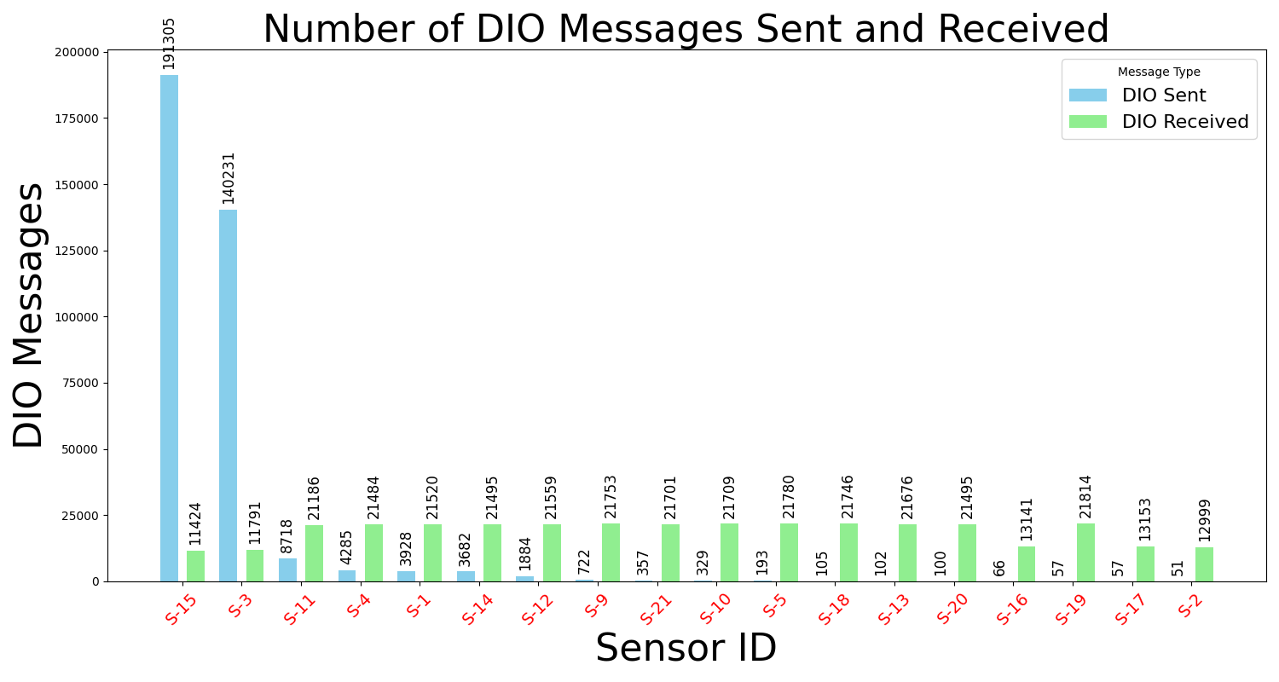
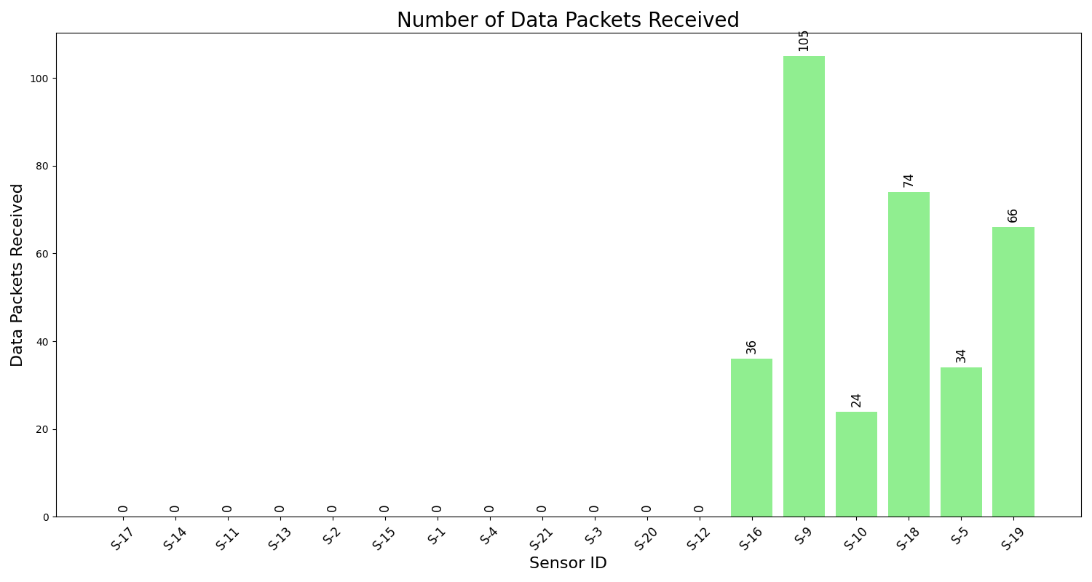
Feature visualization: 6 malicious nodes; 3 runs, each with a different random seed

Slide 19
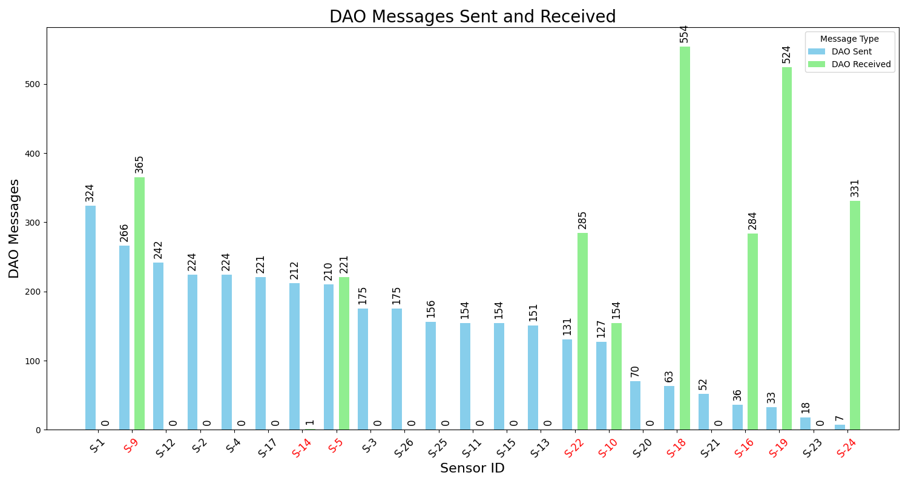
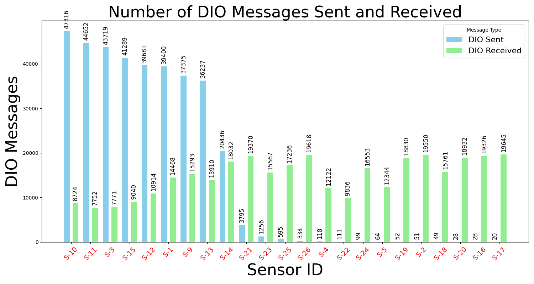
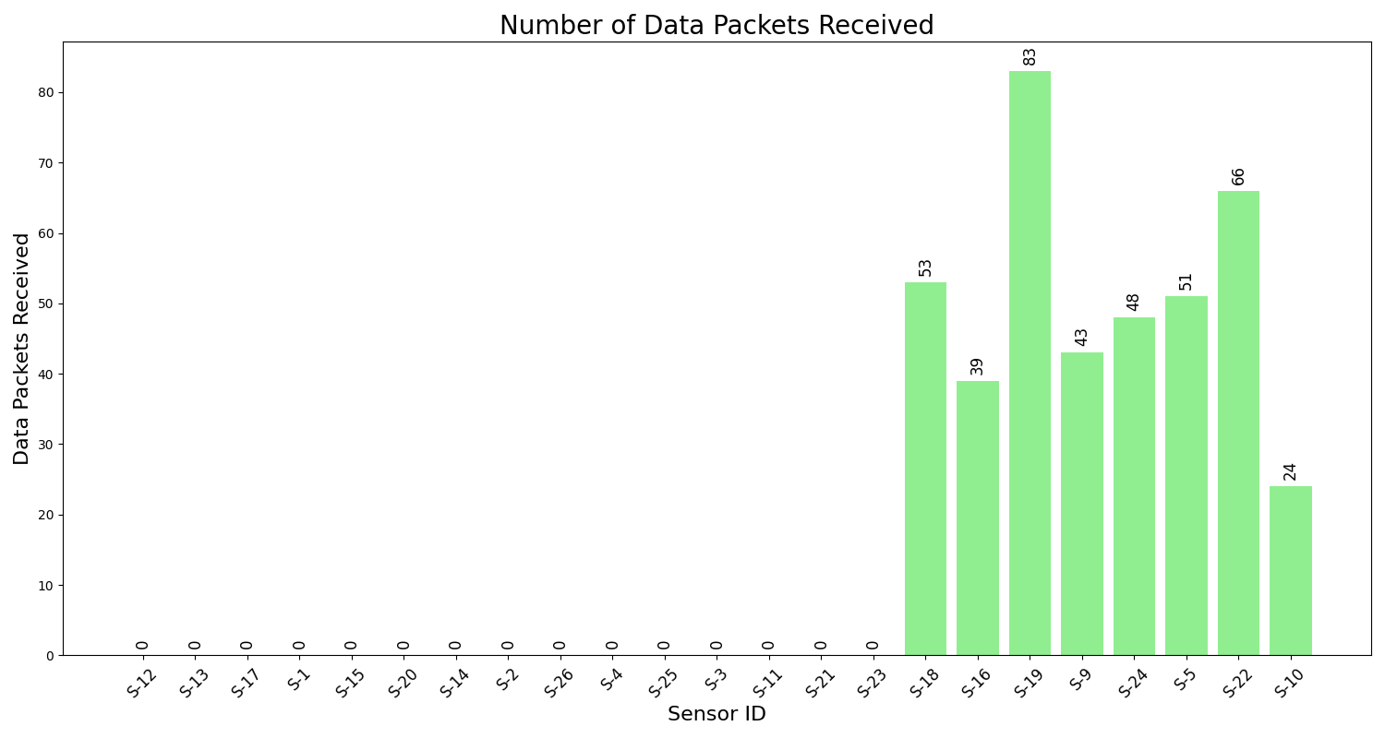






Feature visualization: 8 malicious nodes; 3 runs, each with a different random seed

Slide 20









Feature visualization: 10 malicious nodes; 3 runs, each with a different random seed

Slide 21






Feature visualization: 12 malicious nodes; 3 runs, each with a different random seed

Slide 22









Feature visualization: 14 malicious nodes; 3 runs, each with a different random seed

Slide 23
Classifier Training
Features data was used to train the following classifiers:
K-Nearest Neighbor
Naive Bayes
Support Vector Machine
Logistic Regression

Slide 24
Inference

Slide 25

Inference and Test Scenarios
Created 6 new scenarios with different node counts (9 to 42)
Malicious node count: 3, 7, 9, 11, 13, and 15
Simulations run with 3 random seeds for each scenario
The network topology in IoT using RPL Protocol includes 3 malicious nodes

Slide 26









Feature visualization: 3 malicious nodes; 3 runs, each with a different random seed

Slide 27









Feature visualization: 7 malicious nodes; 3 runs, each with a different random seed

Slide 28









Feature visualization: 9 malicious nodes; 3 runs, each with a different random seed

Slide 29









Feature visualization: 11 malicious nodes; 3 runs, each with a different random seed

Slide 30






Feature visualization: 13 malicious nodes; 3 runs, each with a different random seed

Slide 31









Feature visualization: 15 malicious nodes; 3 runs, each with a different random seed

Slide 32
Confusion matrix
Confusion matrix summarizes the performance of a machine learning model on a set of test data.
Displays the number of accurate and inaccurate instances based on the model’s predictions.
Used to measure the performance of classification models
Confusion matrix components:
True Positive (TP): Predicted as positive, and it actually is positive.
True Negative (TN): Predicted as negative, and it actually is negative.
False Positive (FP): Predicted as positive, but it is actually negative.
False Negative (FN): Predicted as negative, but it is actually positive
Performance metrics:
Accuracy: The overall correct predictions (TP + TN) divided by the total number of instances.
Precision: The number of true positives divided by the total number of predicted positives (TP + FP).
Recall: The number of true positives divided by the total number of actual positives (TP + FN).
F1 Score: The harmonic mean of precision and recall, providing a balance between the two.

Slide 33


Confusion Matrix: Accuracy, Precision, F1 Score, Recall
Metric | Value
Accuracy | 0.8896
Precision | 0.8556
Recall | 1.0000
F1 Score | 0.9222
Metric | Value
Accuracy | 0.9538
Precision | 0.9341
Recall | 1.0000
F1 Score | 0.9659

Slide 34


Confusion Matrix: Accuracy, Precision, F1 Score, Recall
Metric | Value
Accuracy | 0.9980
Precision | 1.0000
Recall | 0.9969
F1 Score | 0.9985
Metric | Value
Accuracy | 0.9237
Precision | 0.8956
Recall | 1.0000
F1 Score | 0.9449

Slide 35
Comparison and Future Work
Classifier | True Positives | True Negatives | False Positives | False Negatives | Accuracy | Precision | Recall | F1 Score
Naïve Bayes | 324 | 174 | 0 | 0 | 1.0000 | 1.0000 | 1.0000 | 1.0000
KNN | 324 | 165 | 9 | 0 | 0.9819 | 0.9730 | 1.000 | 0.9863
Logistic Regression | 324 | 155 | 19 | 0 | 0.9618 | 0.9446 | 1.000 | 09715
SVM | 324 | 172 | 2 | 0 | 0.9960 | 0.9939 | 1.000 | 0.9969
Key Observations
High Precision (>94%): Low false positive rate; malicious classifications are likely correct.
Near-Perfect Recall (≥99.69%): Classifiers rarely miss malicious nodes.
Robust F1 Scores (>0.97): Well-balanced performance in identifying threats and avoiding false alarms.
Future Work
Testing with larger networks
Exploring other types of IoT network attacks
Choukri et al., “RPL rank attack detection using Deep Learning,” 2020 International Conference on Innovation and Intelligence for Informatics.

Slide 36
Appendix: How-to-Guide

Slide 37


How to classify the data?
To generate an excel file containing the 5 feature message counts for each sensor, follow these steps:
Modify the file paths in the Python script according to your setup.
Open the command prompt.
Navigate to the folder containing the Python script.
Run the FeatureCount.py script to process the packet trace file and generate the Excel file.
You can place the Python script anywhere, as long as the file paths are correctly set to locate the necessary data files, including the test and training data scenarios that contain the packet trace files.
After running the script, it will generate the Sensor_Message_Count.csv file in each folder containing a packet trace.

Slide 38


How to Normalize the data?
To generate an excel file containing the normalization of 5 feature message counts for each sensor, follow these steps:
Modify the file paths in the Python script according to your setup.
Open the command prompt.
Navigate to the folder containing the Python script.
Run the Normalize.py script to process the Sensor_Message_Counts file and generate the normalized Excel file.
You can place the Python script anywhere, as long as the file paths are correctly set to locate the necessary data files, including the test and training data scenarios that contain the Sensor_Message_Counts.csv.
After running the script, it will generate the merged and normalized data file in the folder containing the Python script.

Slide 39


How to generate plots?
Download the workspace and place it in your desired location.
The Python scripts can be placed anywhere, as long as the file paths are correctly set.
Modify the file paths in the Python scripts according to your setup.
Open the command prompt.
Navigate to the folder containing the plot-related Python scripts.
Run the DAO, DIO, and Packet Received scripts present in the plots folder to process the packet trace files and generate the plots.
Ensure the necessary packet trace files are accessible based on the paths defined in the scripts.

Slide 40


How to run the classifiers?
Along with normalizing the data, the process will generate `test_data` and `training_data` files.
Run the `Data Classifier.py` script using the trained data by providing the file paths for both the `Trained-Data` and `Test-Data`.
Modify the file paths in the `Data Classifier.py` script according to your setup.
Open the command prompt and run the script as shown below:
The Python script generates six sets of predicted labels and uses this data to create confusion matrices.

Slide 41


How to get the confusion matrix?
After obtaining the predicted labels from the classifiers, use the predicted label Excel files along with the real training data.
Place the predicted label Excel files and the `confusion.py` script in the same folder.
Modify the file paths in the `confusion.py` script according to your setup.
Open the command prompt and navigate to the folder containing the `confusion.py` script.
Run the script as shown below:
The script will generate a confusion matrix for each classifier based on the data provided.

